Slide 1


Financial Education Class 7 & 8
Notes:
Slide 1 : Cashflow
The goal of today’s financial class is to learn about the word cash flow. What does it mean?

Slide 2


Let’s Work !
TAKE YOUR BOOK
READ CHAPTER 3 & 4
WRITE DOWN IN THE PPT TEMPLATE YOUR KEY LEARNINGS !
Notes:
Let’s Work !
Read the first two chapters of your book and write down your key learnings and financial goals in the powerpoint template.

Slide 3



Review Chapter 3 Budget
Let’s see what …you learned from Chapter 3.
Notes:
Slide 1 :

Slide 4
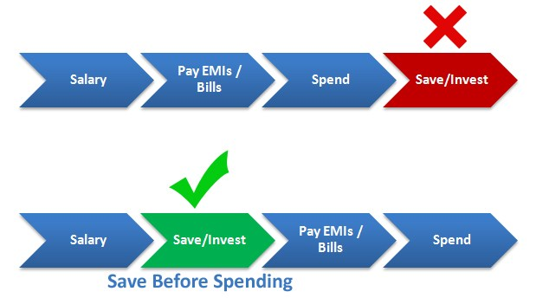
Review Chapter 3 Budget
Let’s see what …you learned from Chapter 3.
ALWAYS PUT MONEY ASIDE BEFORE SPENDING IT ! MAKE SURE YOU CAN NOT SEE IT !
Notes:
Slide 1 : What

Slide 5




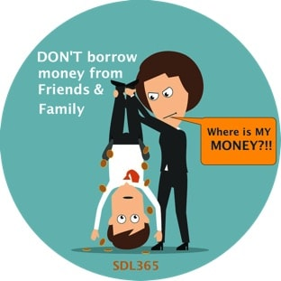
Review Chapter 4
5 Ways to get money when you are young….
Allowance from parents
Money gifts
Earn money from
your investments
Money for household tasks
Borrow money
Notes:
Slide 1 :

Slide 6

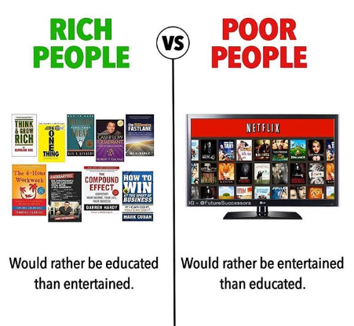

Slide 7
Financial Education Class Kids Slides
Notes:
Slide 1 : Cashflow
The goal of today’s financial class is to learn about the word cash flow. What does it mean?

Slide 8
Let’s Work !
TAKE YOUR BOOK
READ CHAPTER 7 & 9
WRITE DOWN IN THE PPT TEMPLATE YOUR KEY LEARNINGS !
Notes:
Let’s Work !
Read the first two chapters of your book and write down your key learnings and financial goals in the powerpoint template.

Slide 9


Chapter 3 : Make a Budget
Write down Key Learnings from Chapter 3
A budget will help you reach your financial goals.
If your budget is blown, you need to either increase income, decrease expenses or do a little of both.
To meet your savings goals, PYF(Pay Yourself First).
Notes:
Slide 2 :

Slide 10

Chapter 4 : 5 Ways to Make Money Online
Write down Key Learnings from Chapter 4
There are five ways to make money: allowance, work, gifts, loans, and interest on investments.
To earn 1 million, you have to start small-set a goal of making 100
Don't steal it. Ever. Making 1 million is impossible if you're behind bars.
Notes:
Slide 2 :

Slide 11


Chapter 7 : Save, Save, Save !
Write down Key Learnings from Chapter 7
Open a savings account and make regular deposits, and save, save, save.
Think about not spending money.
Know the difference between wants and needs.
If you spend you have to think how that money can come back to you

Slide 12


Chapter 9 : Investing
Write down Key Learnings from Chapter 9
All investments come with risks.
Diversify to spread the risk.
Only invest money you can afford to lose
Notes:
Slide 2 :

Slide 13

KEEP ON LEARNING EVERY DAY…

