Slide 1

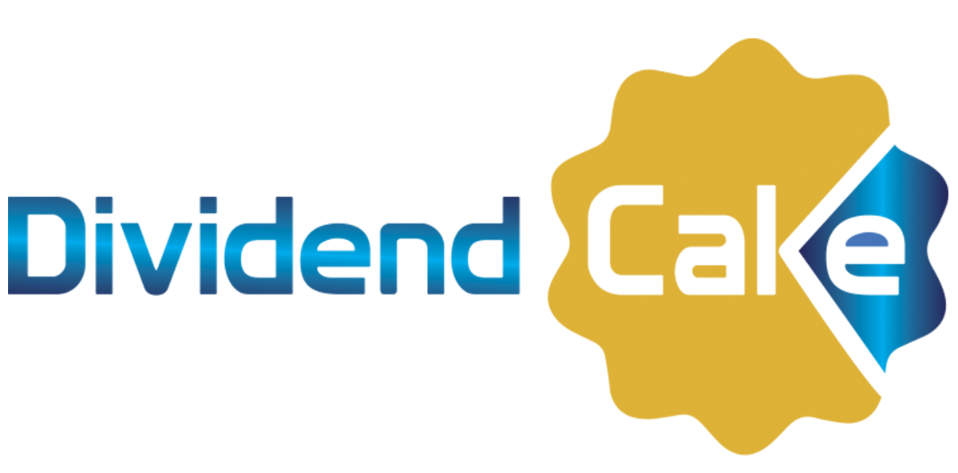
Financial Education Class 3 : Cash Flow
Notes:
Slide 1 : Cashflow
The goal of today’s financial class is to learn about the word cash flow. What does it mean?

Slide 2
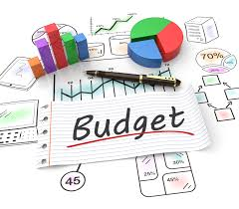
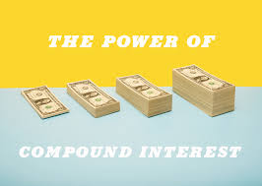
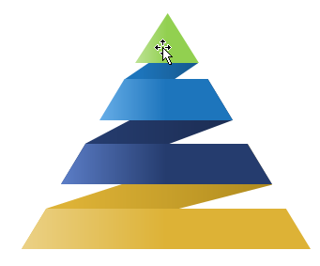
What did you learn last time ?
Let’s see what …you remember from the 2017 Financial Education classes.
THE FINANCIAL PYRAMID
Notes:
Slide 1 : What did you learn last time ?
Last year in 2017, we did teach you 3 financial education classes. One class about budget, one about the compound interest and one class about the financial pyramid. Remember ?
You can tell me what you remember of those classes.

Slide 3
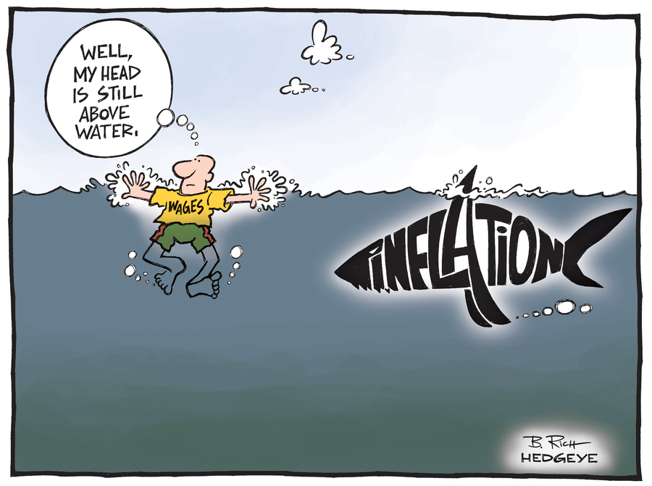
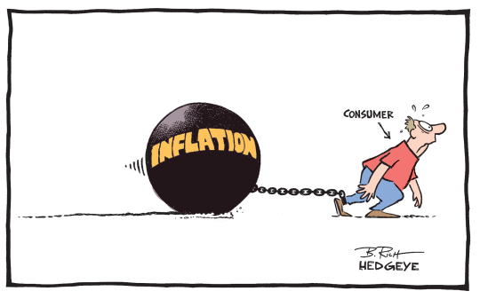
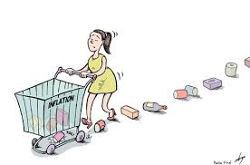
What did you learn last time ?
YOUR WHOLE LIFE WILL BE IMPACTED BY
INFLATION !!
Notes:
The last class we did learn about the meaning of inflation and how it impacts your financial life. This topic "inflation" will impact your whole life. Why ? Because it has an impact on your savings, your expenses,...everything. So it is very important you understand what inflation means and how you should act going forward...got it?
Tell me again what it does mean....

Slide 4
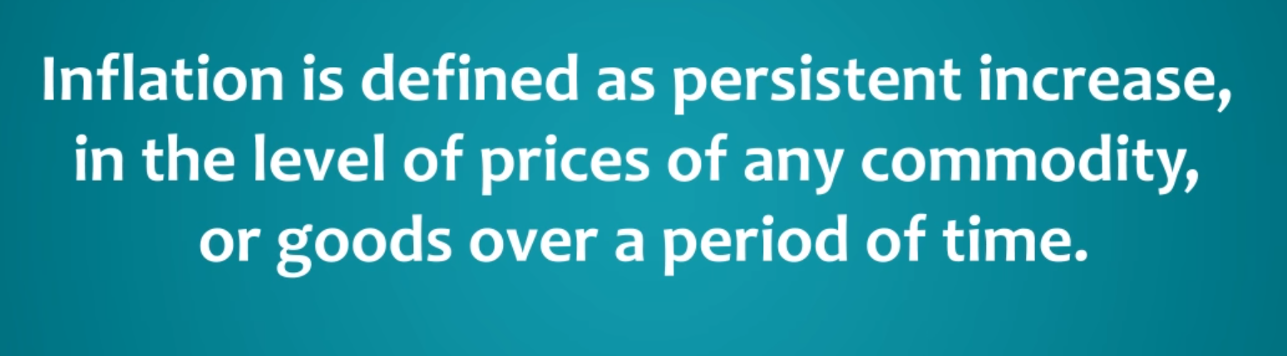
DEFINITION OF INFLATION
Notes:
Slide 3 : The definition of inflation
Read the definition of inflation. This is what we learned last time. It is when prices of goods and services are constantly going up. You don’t know about this as today you pay 1 euro but tomorrow you pay 1,15 euro. Small increases of prices over time.

Slide 5
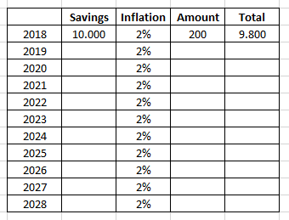
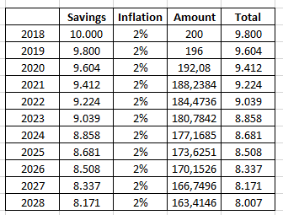
What is the impact of Inflation on your Savings Account ?
YOU LOSE PURCHASING POWER YEAR OVER YEAR !
AFTER 10 YEARS YOU LOSE 2000 EURO WITHOUT DOING ANYTHING ! YOUR 10.000 IS NOW ACTUALLY 8.000 EURO…
Notes:
Slide 4 : The impact on your Savings Account
But increasing prices has also an impact on your savings account. You lose purchasing power year over year. If you have 10.000 Euro, you can only buy goods for 8000 euro. Do you know how much interest you get on a savings account today ?
So you can buy less with this 10.000 euro.

Slide 6
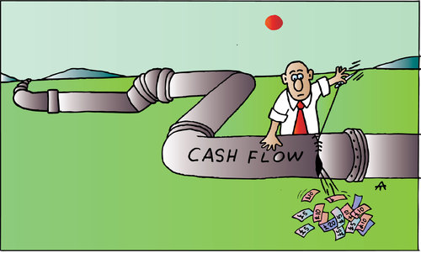


Financial Class 3 : WHAT IS CASH FLOW ?
Notes:
Slide 5 : What is Cash Flow?
Today we will learn what cash flow means...this is about cash flow of money.

Slide 7

Learn first : What is Cash Flow ?
Make your Cash Flow from Investments most important
A cash flow describes a real or virtual movement of money:
a cash flow in its narrow sense is the difference between income payments and expenses payments during a period of time
it is however popular to use cash flow in a less specified sense describing (symbolic) payments into or out of a business, project, or financial product.
Notes:
Slide 6 : What is Cash Flow?
A cash flow describes the movement of money. It is in its narrow sense the difference between income payments and outgoing expenses. In a project you can pay money for a future income.

Slide 8
Cash Flow of a middle-class family
Create a clear overview of all your cash flow
INCOME
Income
This is mainly the monthly salary of the family members.
ACTIVA & PASSIVA
The salary is mainly consumed by the passiva (the house) and things that cost money. The focus is to pay off debt and save what’s left.
EXPENSES
Expenses
This is mainly the mortgage for the house, fixed costs as car, insurances, clothing, food, vacation and other expenses.
Activa
Passiva
Notes:
Slide 7 : Cash Flow of a middle-class family
In this slide you see the income and expenses of a middle-class family. The salary of the husband and/or wife are consumed with paying the bills. Electricity bills, water bill, insurances,...are all expenses. The focus of a middle-class family is to pay the bills and pay off debt and only save what is left.

Slide 9
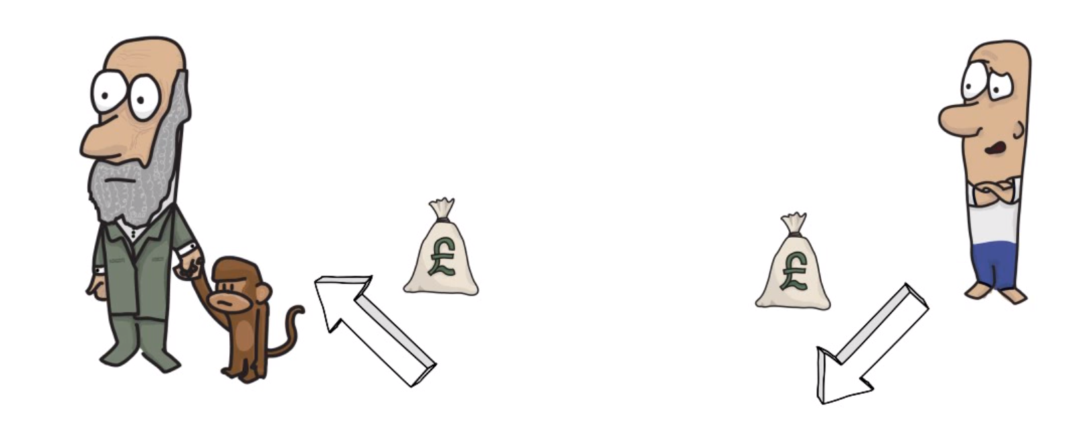




Cash Flow of a Bank
THE BANK GIVES A LOAN TO A PERSON. COMPANY OR GOVERNMENT
AT 3% OR MORE
YOU PUT MONEY ON YOUR SAVINGSACCOUNT AND EARN 0,11% OR LITTLE MORE
Notes:
Slide 8 : How banks work with your money
Let’s begin with explaining how banks operate with your money. You put the money you get from grandmother in a savings account. The bank will pay you minimum 0,11% on the money you park there. They take that money and give it someone else who want to take a loan to buy a house, a car, a vacation, start a company at 3%. A government also takes loans with central banks. The ratio from savings towards loans is around 1:10. They can give a % money to 10 people for every person putting money on the bank.
So I ask the kids...is the bank earning money ? They figure it out quickly.

Slide 10
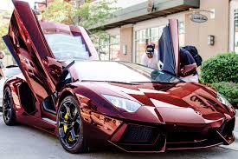

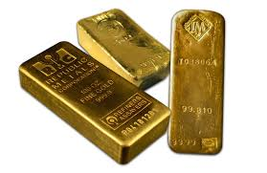

Do the following Assets generate Cash Flow ?
THE FOLLOWING 4 ASSETS ONLY COST YOU MONEY !
Notes:
Slide 9 : Do the following assets generate money ?
So does a car give you money ? Does a house give you money ? Does a bar of gold give you money ? Does a boat give you money ? The answer is NO. They all cost money and cars, boat prices depreciate normally very quickly.
The 4 assets only cost you money !

Slide 11


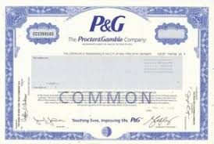


Do the following Assets generate Cash Flow ?
RENT A ROOM IN YOUR HOUSE
THE FOLLOWING 4 ASSETS GIVE YOU MONEY !
STOCK OF PROCTER&GAMBLE
USE YOUR CAR TO EARN MONEY
Notes:
Slide 10 : Do the following assets generate cash flow ?
The first one is a savings account. Yes, this generates extra money…very little 0,11% today. The second one is renting a room in your house. If you find a person who wants to rent you room for several months, you generate extra cash flow from your room.
If you buy toilet paper to clean your butt, you might use toilet paper from the company Procter & Gamble. This company can make profit and you can become owner of a piece of this company when you buy 1 share of this company on the stock market. Then you are also owner of this company. This company can give you a part of this profit.
The last option is being an entrepreneur or generating extra cash from your car by being an UBER driver. You generate extra cash from driving your car. So these 4 assets generate extra cash for you !

Slide 12
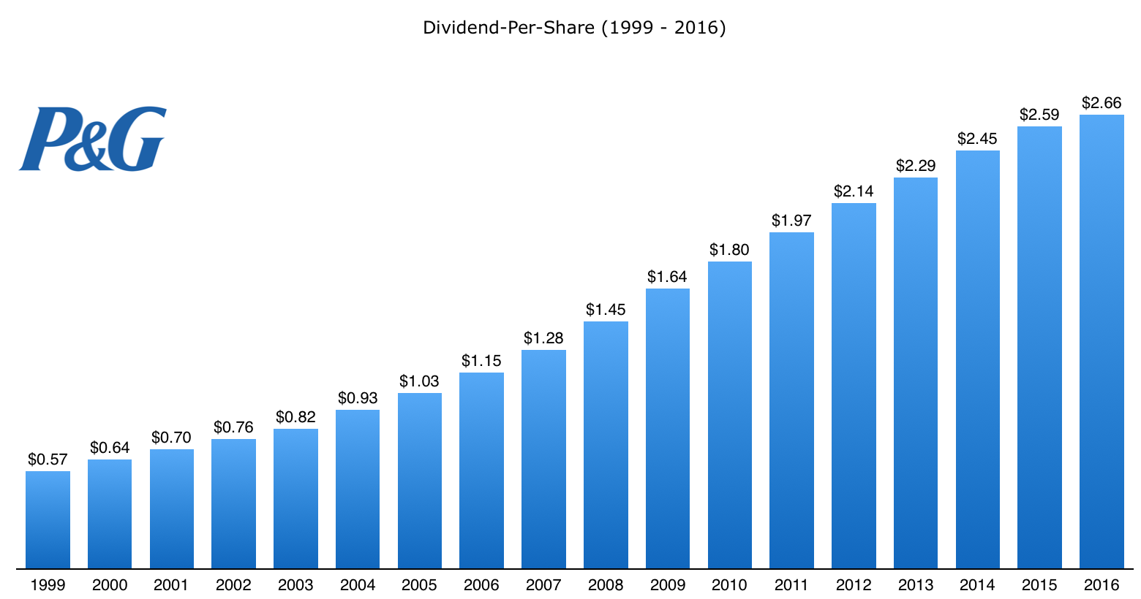
Dividend Cash Payout from Procter & Gamble
IF YOU BUY TOILET PAPER OF THIS COMPANY
THEY PAY YOUR DIVIDEND OF ALL THE PROFIT THEY MAKE !
IN 2016 YOU RECEIVED 2.66$ FOR EVERY SHARE YOU BUY ! THEY PAY MORE EACH YEAR
1000 SHARES EQUALS 2660$
Notes:
Slide 11 : Dividend Cash Payout from Procter & Gamble
As you can see on this slide, Procter & Gamble company has been paying out each year a dividend cash payout. Each year a little more. So if you purchased 1000 shares of this company, you would have received 2660 $ per year in 2016. You can pay a nice vacation for that money.

Slide 13
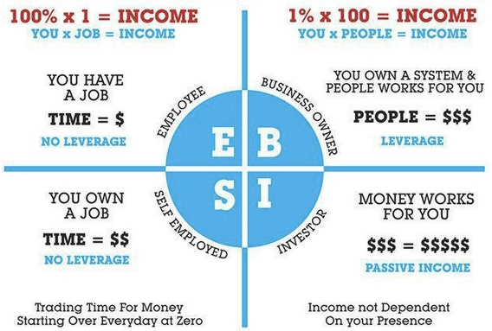
Cash Flow Quadrant
Make your Cash Flow from Investments most important
Notes:
Slide 12 : Cash Flow Quadrant
There are 4 types of cash flow people. You can be an employee or self-employed such as a doctor or a dentist. So here you have a job in a company or at the government or you own a job. You get paid for your time. 95% of the people do this until they die.
More important is the other side of the quadrant. You can be a business owner. A person with multiple restaurants such as Pizza Hut has a system of selling pizzas where other people work for him. He has a system. You can also be an investor and then money works for you. If you buy shares of the company Procter & Gamble you are an investor. You receive passive income in the form of dividends. Your income is not dependent on you being present all the time.

Slide 14


Let’s Work !
TAKE YOUR BOOK
READ CHAPTER 1 & 2
WRITE DOWN IN THE PPT TEMPLATE YOUR KEY LEARNINGS !
Notes:
Let’s Work !
Read the first two chapters of your book and write down your key learnings and financial goals in the powerpoint template.

Slide 15

KEEP ON LEARNING EVERY DAY…

