Slide 1


INFLATIE : Hoe verlies je geld zonder het te beseffen ?
Notes:
Slide 1 : Inflation – How you lose money without realizing it
The goal of today’s financial class is to learn about the inflation and how it impacts your financial life. This topic "inflation" will impact your whole life. Why ? Because it has an impact on your savings, your expenses,...everything. So it is very important you understand what inflation means and how you should act going forward...got it?

Slide 2
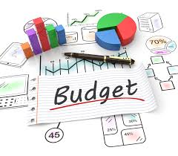
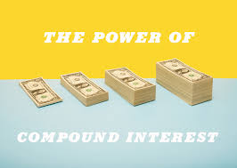
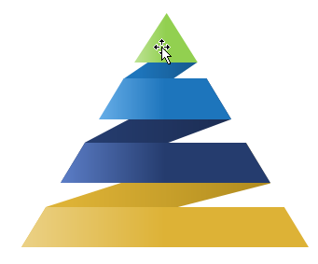
Wat heb je de vorige lessen geleerd ?
Laat ons even zien…wat herinner je je van de financiële lessen van 2017 ?.
Budget beheer
De Samengestelde Interest
Jouw Financiële Piramide
Notes:
Slide 2 : What do you remember from last financial classes ?
The goal of today’s financial class is to learn about the inflation and how it impacts your financial life. This topic "inflation" will impact your whole life. Why ? Because it has an impact on your savings, your expenses,...everything. So it is very important you understand what inflation means and how you should act going forward...got it?

Slide 3
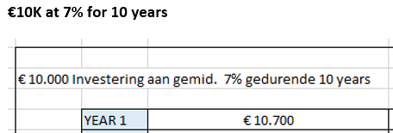
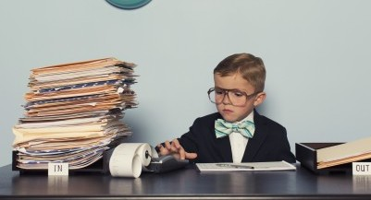
Oefening 1 : Laat ons wat wiskunde doen..
10.000 Euro – 7% gedurende 10 jaar
Je krijgt 10k van me
Vandaag op een spaarrekening krijg je 0,11% interest…je wordt armer elke maand
Je geld groeit 7% per jaar
Hoeveel geld heb je in jaar 10 ?
Wat gebeurt er met je maandelijks bedrag?
Wat zijn je conclusies ?
Vraag hulp als je het niet begrijpt…

Slide 4

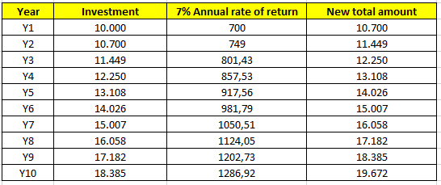
Antwoord op oefening 1

Slide 5
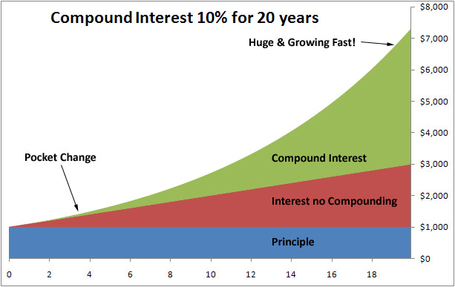
Basisonderdelen van samengestelde interest
Jaarlijkse % groei van je geld (Hoe snel kan je je geld laten groeien…)
TIJD
HOEVEEL VOEG JE TOE ELK JAAR?

Slide 6




Vraag : Jouw Financiële Piramide
Geef de naam van elke laag uit de financiële piramide en het doel
STAP 4 -> LAAG 4
STAP 3 -> LAAG 3
STAP 2 -> LAAG 2
EERSTE STAP -> LAAG 1

Slide 7
ANTWOORD : Jouw Financiële Piramide
Jouw Investeringen
In het begin zullen je investeringen in dividend aandelen of andere activa klein zijn maar pas de juiste strategie toe en langzaam aan zal je piramide draaien
Jouw Spaarplan voor je kids of andere doelen
Spaar een vast bedrag voor een specifiek doen of droom die hebt. Je kan ook geld sparen voor je kinderen of kleinkinderen. Jij beslist.
Jouw Pensioen Spaarplan
Spaar een maandelijks bedrag voor je pensioen. Dit kan door een pensioenspaarfonds, pensioenspaarverzekering of een groepsverzekering bij je werkgever.
Jouw Financiële buffer
Verwezenlijk eerst jouw financiële buffer van 6 tot 18 maanden van je huidig salaris en plaats het op een spaarboekje. Raak het verder niet aan ! Dit is voor onverwachte financiële tegenslagen.

Slide 8
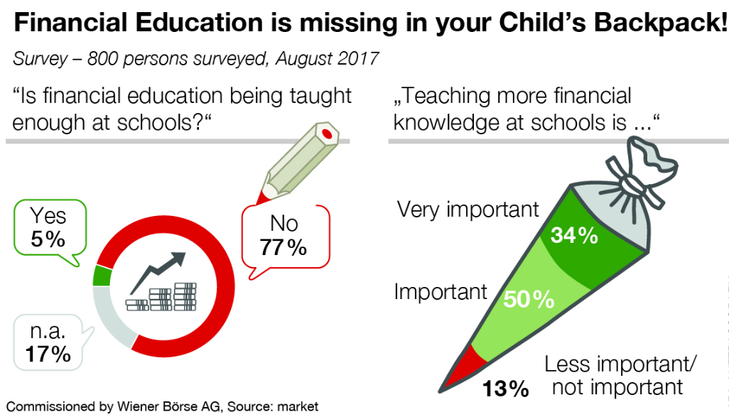
Waarom is Financiële Geletterdheid belangrijk…
Jouw school zal je weinig financële kennis bijbrengen
Notes:
Slide 8 : Why Financial Education is important
Why is financial literacy important? I explain the kids that financial education is simply missing in their weekly schedule. They get both two hours of religion per week. How will religion serve them in their future life ? More than financial literacy? Kids do agree with me !
The numbers in this graph are clear that financial education is NOT taught at schools while it is extremely important!

Slide 9
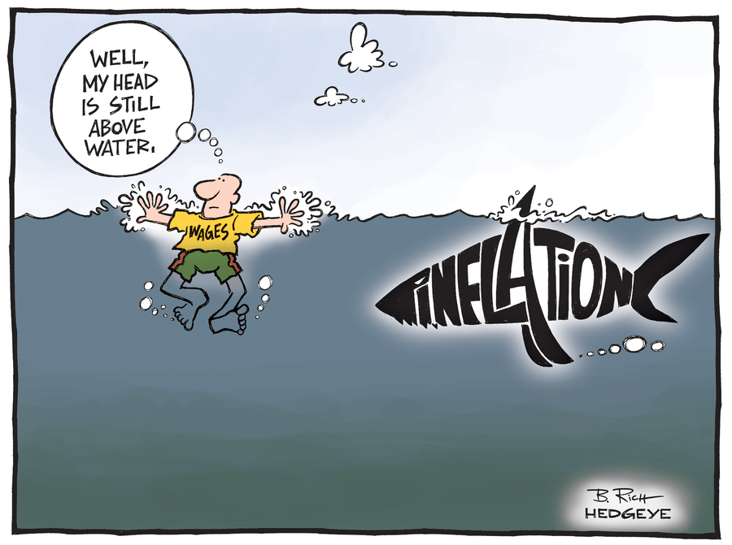
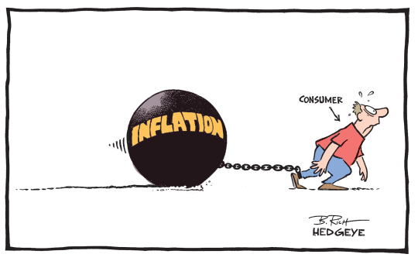
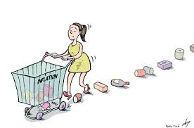
Financiële Les 5 : WHAT IS INFLATIE ?
JOUW GEHELE LEVEN WORDT BEINVLOED DOOR INFLATIE !!
Notes:
Slide 9 : The topic of today’s class : INFLATION
Today’s lesson is about how inflation works and what it does mean. You will be impacted by inflation your whole life ! Governments like inflation. Look at the little guy on the top left. Inflation is a heavy ball around his leg. It is like a hidden shark in the water or a lady losing her shopping goods over time...three great cartoons that represent inflation.

Slide 10
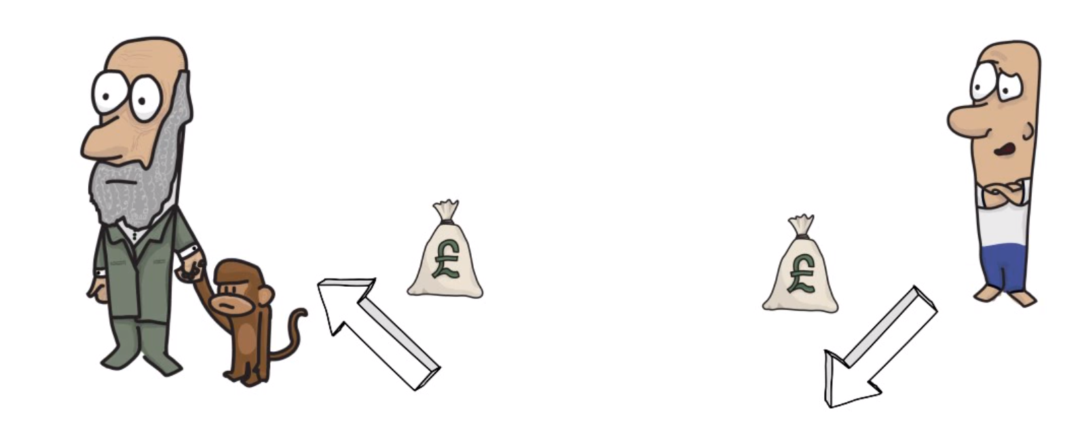




Hoe gebruiken de banken jouw geld ?
De bank leent het aan een andere persoon, bedrijf of de overheid voor 3% of meer….
Je brengt je spaargeld van oma of opa naar de bank en krijgt 0,11% op je geld
Notes:
Slide 10 : How banks work with your money
Let’s begin with explaining how banks operate with your money. You put the money you get from grandmother in a savings account. The bank will pay you minimum 0,11% on the money you park there. They take that money and give it someone else who want to take a loan to buy a house, a car, a vacation, start a company at 3%. A government also takes loans with central banks. The ratio from savings towards loans is around 1:10. They can give a % money to 10 people for every person putting money on the bank.
So I ask the kids...is the bank earning money ? They figure it out quickly.

Slide 11
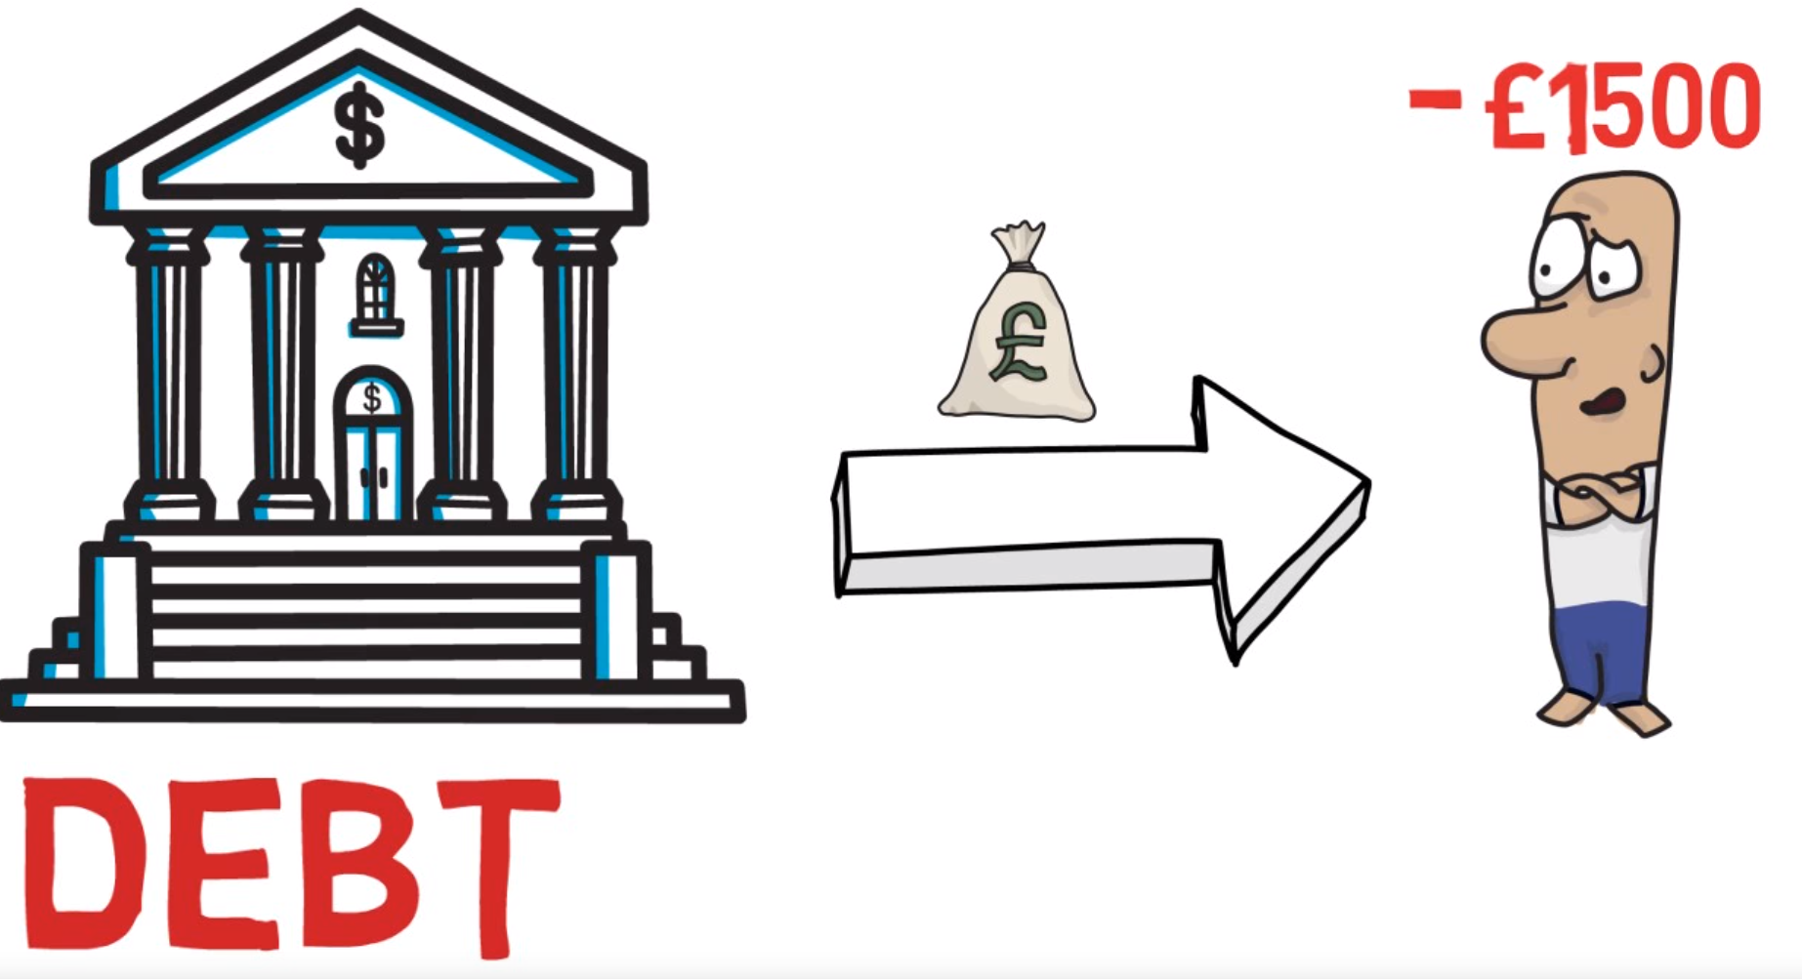
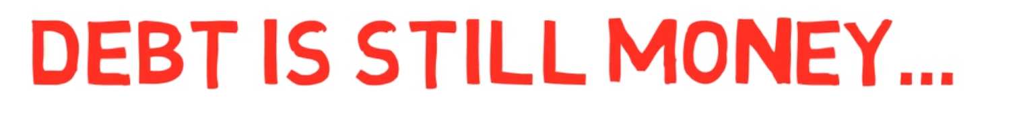
SCHULDEN ZIJN NOG ALTIJD GELD EN MOETEN TERUGBETAALD WORDEN !
Notes:
Slide 11 : Debt is still money
So if you take a loan at the bank as many Americans do for their house, car or study at university, they need to pay that money back. Debt is still money. It is just a matter of how long will it take before you pay it back.

Slide 12

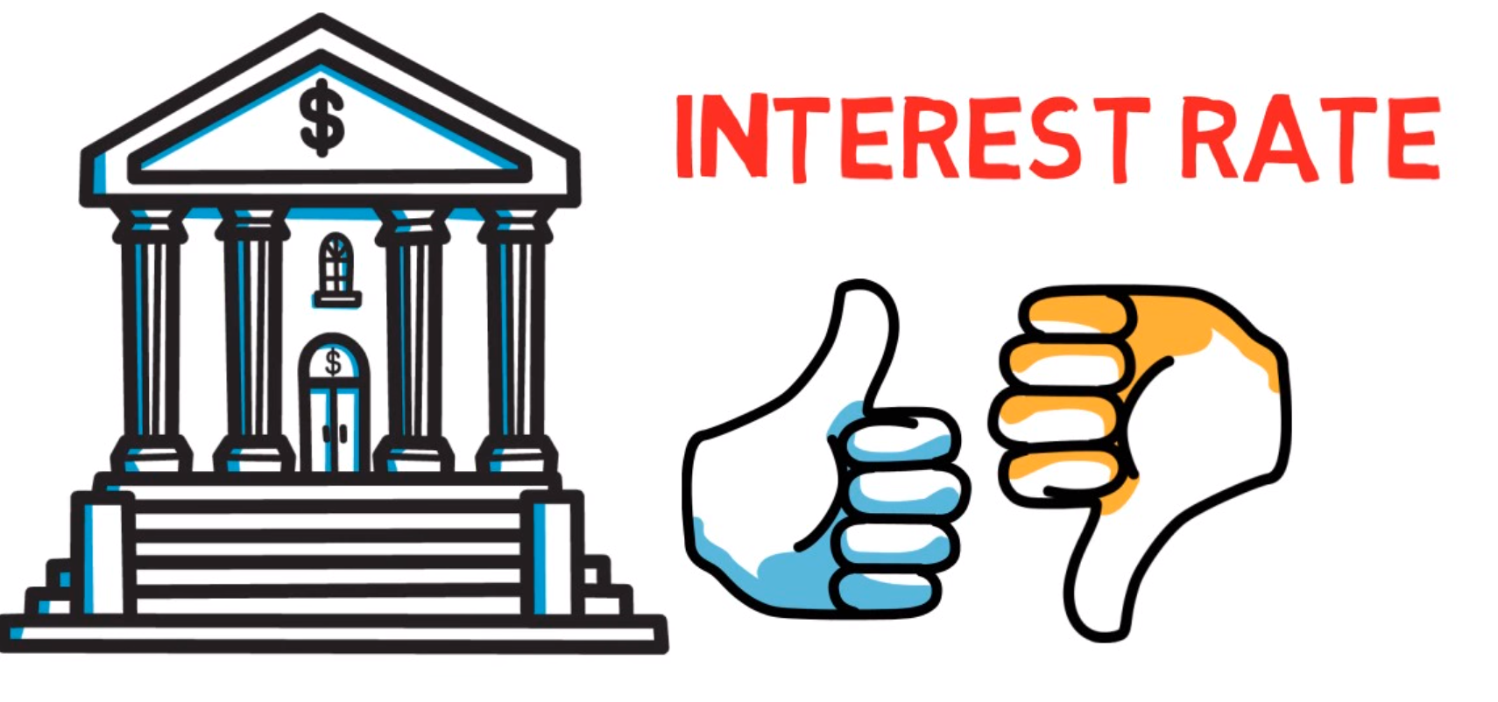
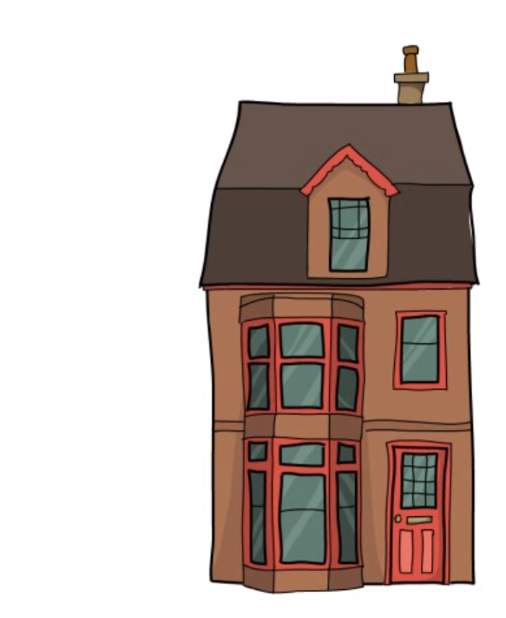
INTERESTEN GAAN SOMS OMLAAN OF OMHOOG. GEZINNEN KOPEN EEN WONING EN MAKEN SCHULDEN
Notes:
Slide 12 : Interest Rate
So each loan has an interest rate. Interest rates are defined by central banks and commercial banks. The higher the interest rate goes, the more you have to pay if you have a variable interest rate. If you have a fixed interest rate, you have a fixed amount to pay. Most Belgians buy a house with a fixed interest rate loan.
Past years this interest rate has been going down. Now it's going up a little again.

Slide 13
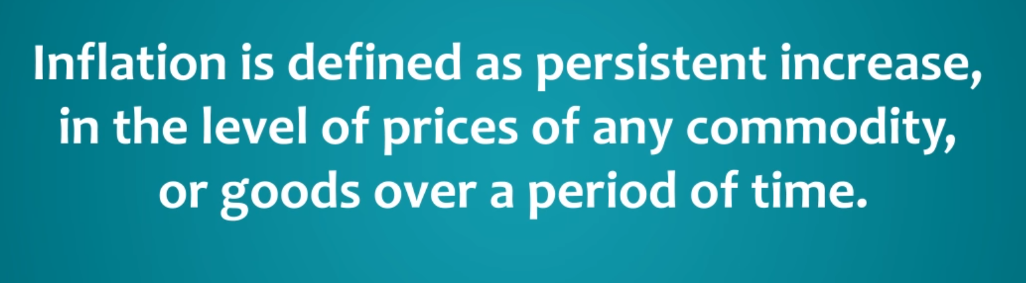
DEFINITIE VAN INFLATIE
INFLATIE WORDT GEDEFINIEERD ALS HET CONSTANT TOENEMEN VAN DE PRIJS VAN GOEDEREN EN DIENSTEN OVER EEN TIJDSPERIODE
Notes:
Slide 13 : The definition of inflation
Read the definition of inflation. Do you understand this ? It is when prices of goods and services are constantly going up. You don't know about this as today you pay 1 euro but tomorrow you pay 1,15 euro. Small increases of prices over time.
Do you understand ?

Slide 14
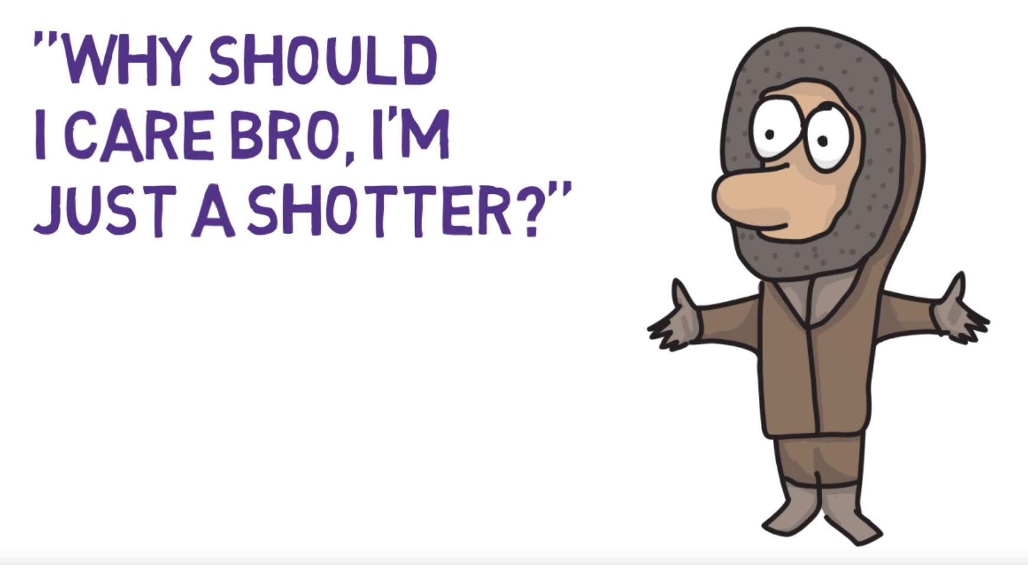
Heeft dit invloed op mijn leven ?
Notes:
Slide 14 : Why should I care Brother ?
So why should you care ? Well inflation means that if prices goes up, your expenses will increase. For example, if you rent a house and your contract says "Rent will be adjusted according to inflation rate", that you will pay more each year to a new adjusted inflation rate monthly fee. Got it?

Slide 15
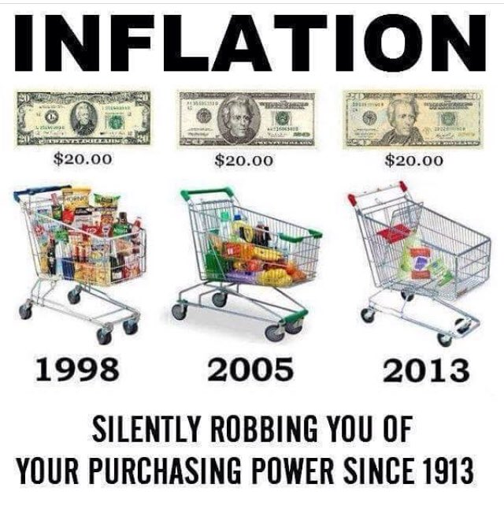
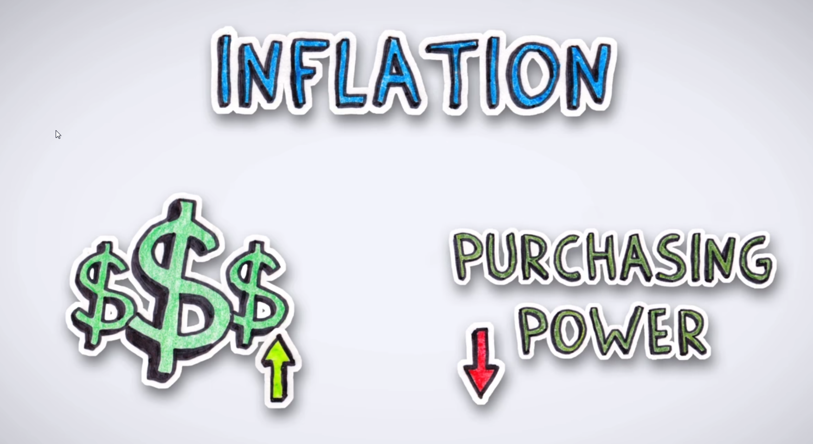
Verlies van koopkracht…
DE PRIJZEN STIJGEN
JOUW KOOPKRACHT DAALT
Notes:
Slide 15 : Losing Buying Power
Let’s take a look at the left image. What do you see ? You can see the shopping basket of the year 1998, 2005 and 2013. What do you see ? How much can you buy for 20 dollars ?
Inflation is robbing you slowly from your purchasing power. Do you see the difference ? When prices go up, your purchasing power goes down as time goes on.
This is very important to understand !

Slide 16
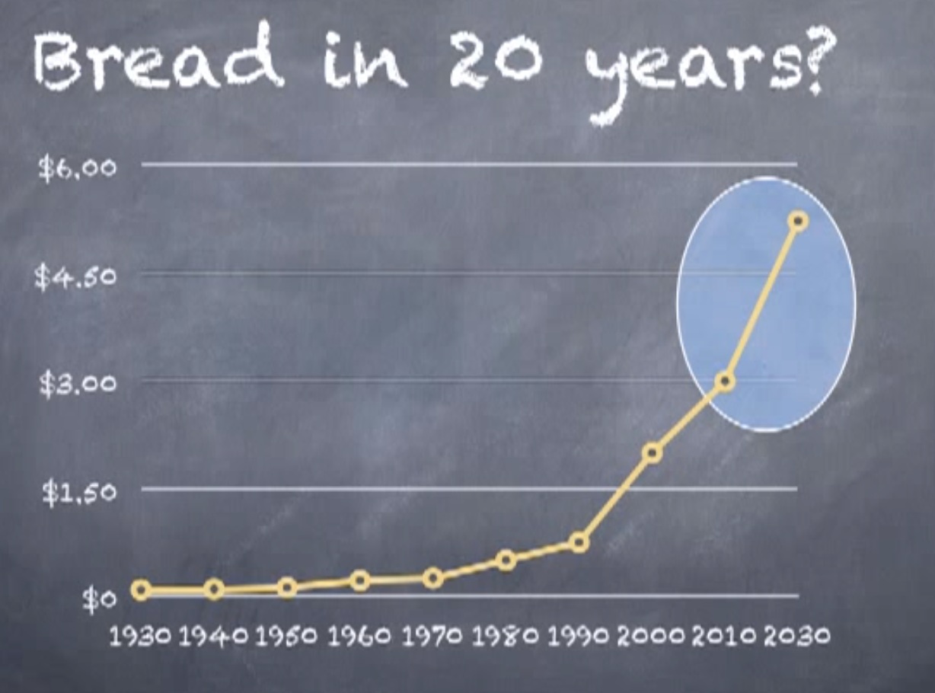
De evolutie van de prijs van brood
Notes:
Slide 16: The evolution of the price of one bread
Here you see the graph of the price of bread. What was the price in the year 1990 ? What was the price in the year 2010 ? What will be the price of bread in 2030? We don't know but you understand now what is happening, right ?

Slide 17
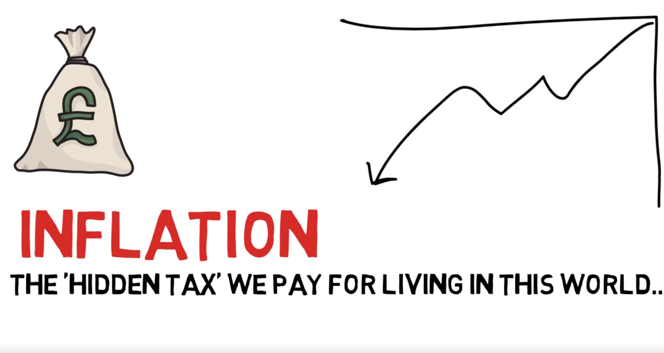
INFLATIE IS EEN VERBORGEN BELASTING !!
Notes:
Slide 17: Inflation
So inflation is actually a hidden tax we pay for living in this world. The prices go up each year and governments also want inflation to go up. So if you don't grow your money higher than inflation, you are losing money.
Do you remember how much interest the bank gives you on your savings account ? Right...o,11%

Slide 18
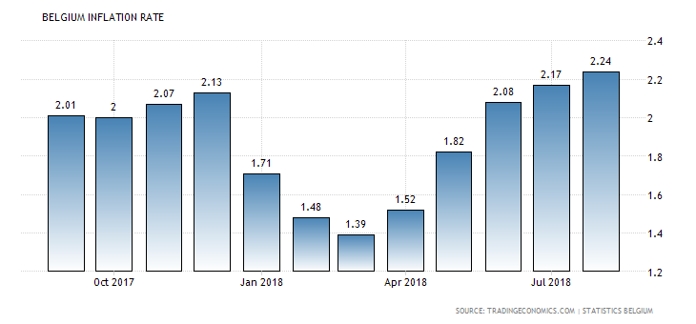
Wat is het inflatie % vandaag in België?
Wat is het inflatie % in Juli 2018 ? Lees af op de grafiek
Notes:
Slide 18 : What is the % Inflation today in Belgium ?
Let's read the following graph. Can you tell me the inflation rate in Belgium in July 2018 ? What is the % ?
So this means 2,17% was the increase in price if your rental contract stated that each July your rental fee will be adjusted according to the inflation rate. Understand ?

Slide 19
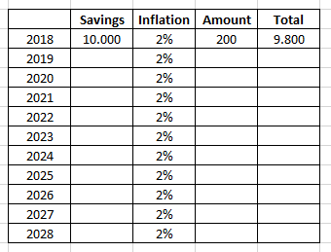
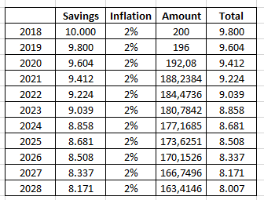
Wat is de impact op je spaarboekje?
Je verliest koopkracht jaar per jaar !
NA 10 JAAR HEB JE 2000 EURO KOOPKRACHT VERLOREN ! JE 10.000 IS NU NOG MAAR 8.000 EURO…
Notes:
Slide 19 : What is the impact on your Savings Account ?
So let's do exercise on the next page. Calculate how much money or buying power you have left after 10 years of an inflation of 2%. It is the same concept of compound interest but now you are losing money.
The answer is : around 8.000. After 10 years you will have lost almost 20% of your buying power. It will still show 10.000 on your bank account but you only have buying power of 8.000 Euro.

Slide 20
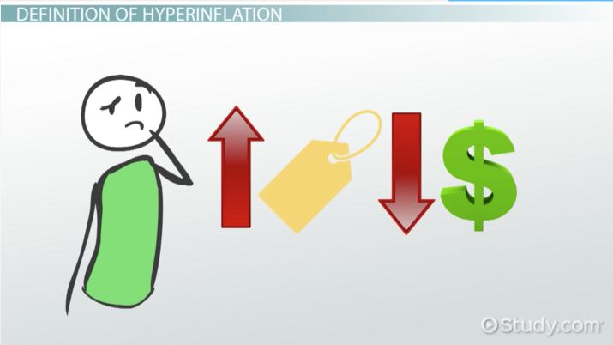
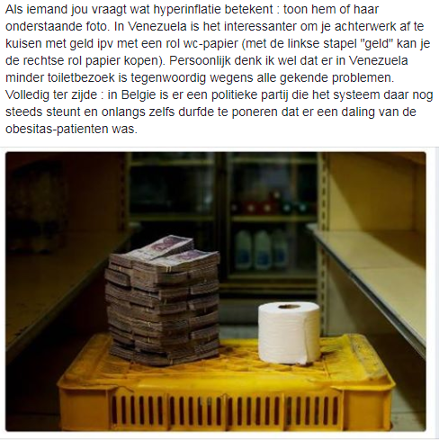
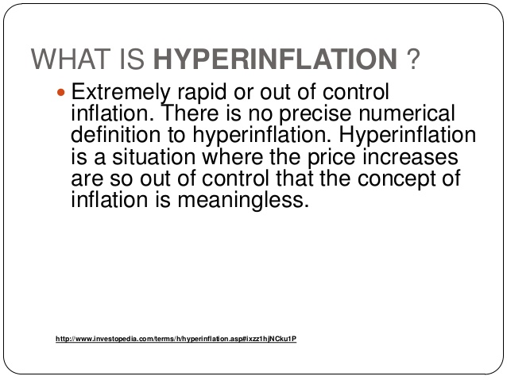
In Venezuela is er HYPERINFLATIE
What is hyperinflation, you think ?
De Prijzen stijgen exponentieel
en je geld verliest zijn totale waarde
Notes:
Slide 20 : In Venezuela They have Hyperinflation
So there's also HYPER inflation. What does that mean ? It means the prices go up exponentially and money is worth almost nothing. Here you see a pile of money on one side versus a roll of toilet paper. Well...the money is worth less than the toilet paper so it's cheaper to clean your butt with the toilet paper...lol !
If your country will do a hyperinflation, run and move to another country. You are in a bad spot !

Slide 21
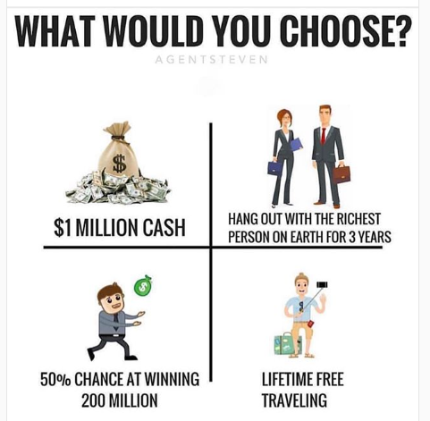
Wat is jouw attitude t.o.v. geld…
Welke keuze maak je?
SCHRIJF NEER WELKE JE KIEST EN WAAROM NIET
KIES JE FAVORIET
LAAT ONS DISCUSSIEREN
Notes:
Slide 21 : Let's find out your financial attitude
Managing money is also about your financial attitude. Let's flip to the next page. Take a look at following money options. Which one would you choose? Write down why you don't want to chose an option and mark which one you would chose?
When the kids are ready, they explain their reasoning.
Son A choses for the 1 million $ cash. This gives financial security. He doesn't think spending time with a rich person provides any value nor money. Lifetime free traveling is nice but not important. No risks for winning the 200 million as you could end up with nothing.
So conclusion of the financial attitude of son A : Risk averse and aiming for financial security. Take the money opportunity and grow your money from there. Son I choses the 50% chance at winning the 200 million. His reasoning is that he has nothing today, so if he has nothing afterwards..nothing changes. If he wins it, he is financially independent and doesn't need to work anymore. Even his family doesn't need to work anymore. The other choices are not appealing to him.
Conclusion of the financial attitude I : Doesn't shy money risks, nor a gamble. Taking the 1 million cash is not sufficient for him...it's not that much money according to him. What do you have left after buying a house and more stuff ? This leads to an interesting discussion and lot of laughter. I explain the kids spending three years with the richest person on earth can teach you how to grow your money, how he made his success and how he can help you to build your own business by mentoring and coaching you. Lifetime free traveling can also teach you many valuable lessons in life. You learn how to deal with travel problems, learn about other cultures and interact with foreign people.

Slide 22
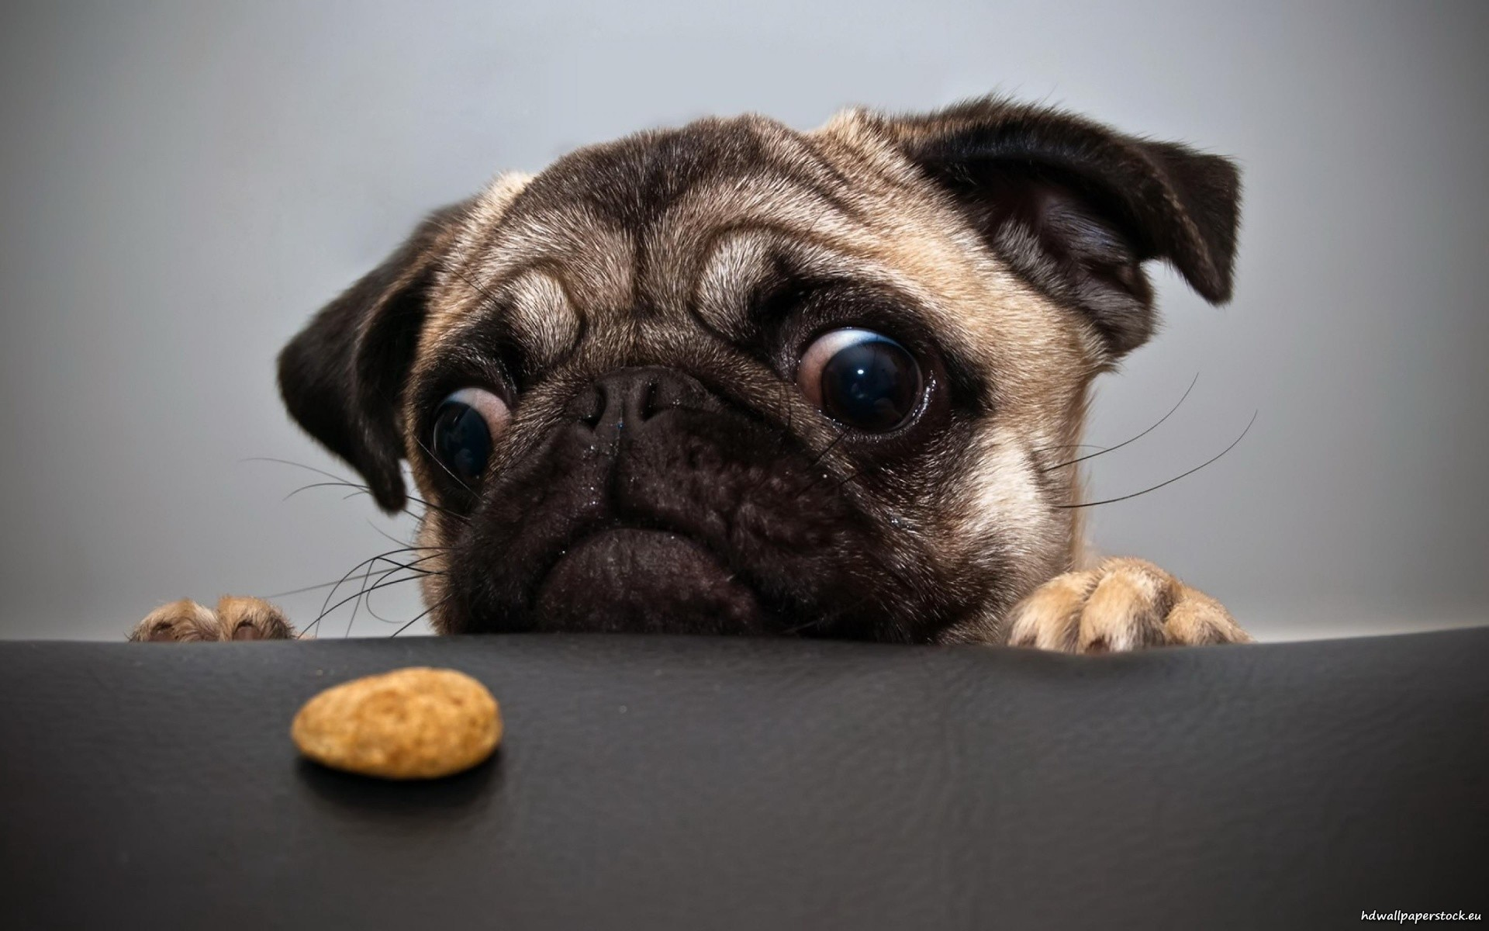

Finale feedback
WAT HEB IK GELEERD?
VERTEL ME DE 3 ZAKEN DIE JE HEBT BIJGELEERD
Notes:
Slide 22 : Final feedback
Time for final feedback. Kids write down their final feedback and what they did learn.

Slide 23

TIJD VOOR EEN GESCHENK
Notes:
Slide 23 : Time for a present
Give your kids an incentive for their attention and great work.

Slide 24
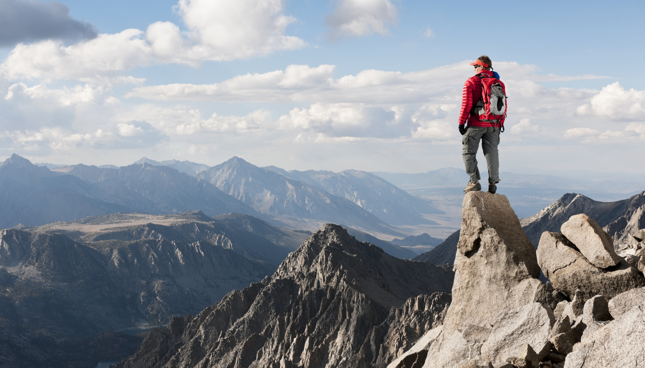
KEEP ON LEARNING EVERY DAY…
Notes:
Slide 23 : Keep on learning EVERY DAY
Never stop learning as this is important in life. Follow your passions and learn, learn, learn...

