Slide 1


Your Financial Pyramid & Creating a Financial Plan
Notes:
Slide 1 : Your Financial Pyramid & Creating a Financial Plan
The goal of today’s financial class is to learn about the financial pyramid. This pyramid is the concept and methodology to manage your money now and in the future. We will also learn how to make a basic financial plan.

Slide 2

What did you learn last time ?
Let’s see what …you remember from the Financial Education class 1 & 2.
Tell me 3 key learnings from
Budg€t Fun
& Compound Interest
Notes:
Slide 2 : What do you remember from last financial classes ?
First of all let’s see what you still remember from previous financial education classes? Tell me what you learned during Budget Fun and The Compound Interest class. Do you still remember the three key components of the compound interest?

Slide 3
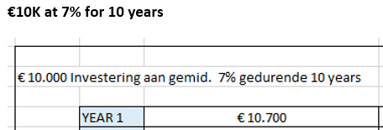

Exercise 1 : Let’s repeat Compound Interest
10.000 Euro – 7% during 10 years
You get each of you 10k from me
Your money grows 7% each year
How much money do you have in year 10 ?
What happens with your monthly amount?
What can you conclude ?
Ask questions if you need help…
Notes:
Slide 3 : Exercise 1 : Let’s repeat Compound Interest
Let us repeat an exercise how to calculate the compound interest. You get 10.000$ and you want to grow your money with 7% per year. How much will you have at the end of year 10? Can you calculate me the correct amount?
Did you know that the majority of young people do NOT know the principle of compound interest? It is one of the most important financial concepts to understand!

Slide 4


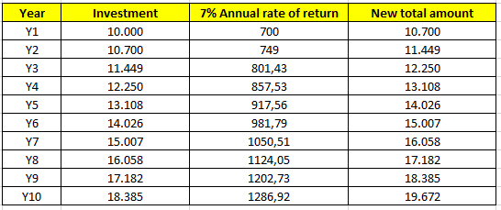
Answer to exercise 1
Notes:
Slide 4 : Answer to exercise 1
Let’s check your answer and let’s see if you calculated correctly. Give me some conclusions from your calculations.
Be aware that as the amount of years increases, the amount grows exponential and you get a snowball effect where the amount grows exponentially.

Slide 5
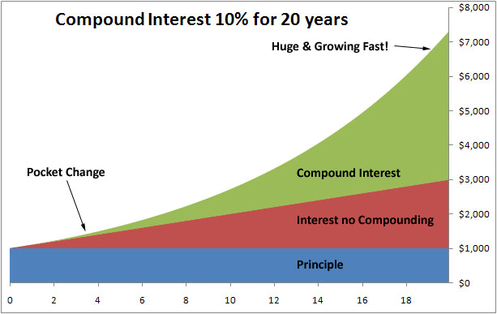
Key Principles of Compound Interest
ANNUAL RATE OF RETURN or GROWTH RATE (How fast you can grow your money…)
TIME
ADDITIONS TO YOUR AMOUNT PER YEAR
Notes:
Slide 5 : Key Principles of Compound Interest
Let’s repeat the three key principles of compound interest. The first one is the annual rate of return or growth rate of your money. How fast can you grow your money ? The second one is TIME. You need to let time do its work and grow it over time. The third and also important factor is your additions to your total amount per year. You can see the effect on the graph. Over time the amount compounded grows exponentially…do you understand this?

Slide 6

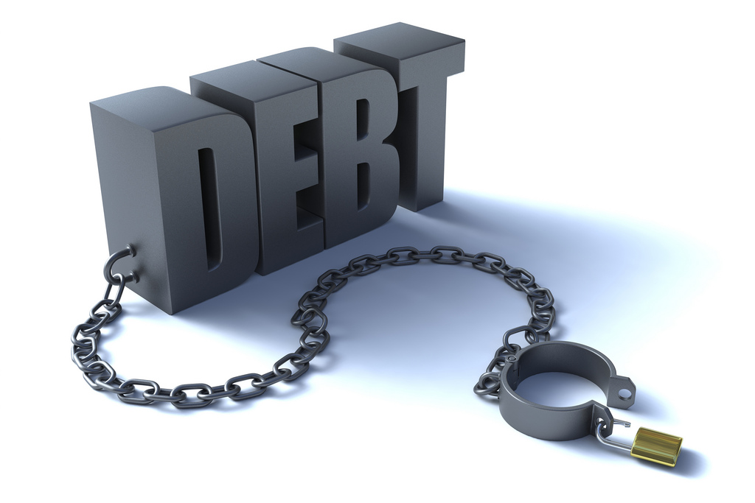

Why Financial Education is important…
Notes:
Slide 6 : Why Financial Education is important…
Why is financial literacy important? Too many young people have a lot of debt. Did you know that the student loans in the USA totals up to 1,3 trillion dollars…isn’t that freaking high? After you finish university, you need to work several years to pay off your debt…how painful is that?
Many millennials never got financial education, not did their parents? Did you know that 30% of Americans cannot pay an unexpected bill of 400$ in a month? Don’t become a slave of debt and paying off your debt. Invest in your financial education.

Slide 7

What you will learn today
Why it is important to have a Financial Plan…learn about the Financial Pyramid
Be happy with what you have.
Money is a tool that can work for you. Use it wisely !
Ask questions if you don’t understand..
LEARN AND HAVE FUN
Notes:
Slide 7 : What you will learn today
Today’s lesson is about the financial pyramid. In your life from young age you need to build out your financial pyramid. You need to execute this step by step. Then we will discuss a basic financial plan. Money is a tool that you can use and need to put at work wisely. Ask questions if you don’t understand something. There are no stupid questions…you only stay stupid if you don’t understand and don’t ask. Learn and have fun !

Slide 8




Your Financial Pyramid
Learn about each layer of your Life Financial Pyramid
Your Investments
At first your investment in dividend stocks or other activa will be small but apply the right strategy and this pyramid will turn
Your Savings for (grand)kids or other goals
Save money for a specific goal or dream that you have. You can also save money for your kids or grandchild. You decide.
Your Pension Saving Plan
Save a defined amount for your pension. This can be done through a pension fund, pension insurance plan or through your employer if they offer it.
Your Financial buffer
Establish your financial buffer of 6 to 18 months of your current salary and don’t touch it. Put it on a savings account for unexpected financial setbacks
Notes:
Slide 8 : Your Financial Pyramid
Let’s begin with the first layer of the financial pyramid. This is the foundation of your financial future. This layer is called your financial buffer or emergency fund. You need to build this financial buffer first before anything else. Got it?

Slide 9

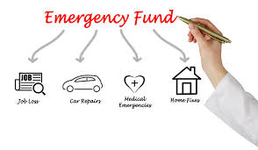
What is Emergency Fund ?
Emergency Fund is money that you need in case of severe problems….
Examples
Your car has a big problem and needs an engine fix…
You need to go to the hospital for urgent operation such as appendicitis
Your wash machine breaks down and you need to buy a new one
The roof of your house starts to leak and you need an expensive repair…
Notes:
Slide 9 : What is Emergency Fund ?
An emergency fund is money easy accessible on a savings account for any emergency that may pop up in your life. You may lose your job, need to fix your car, have to replace a wash machine, pay a high medical cost, whatever in your life that may pop up. You need this financial buffer for emergencies.
So how much money do you need for this emergency fund?

Slide 10

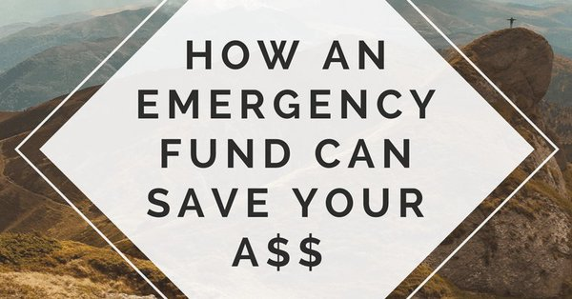
How much money in your Emergency Fund ?
Emergency Fund money is a multiplier of your monthly salary
YOU NEED 6 TO 14 MONTHS OF
YOUR MONTHLY SALARY ON A SAVINGSACCOUNT !!
Example
You have 1500 euro net salary
You are 21 years old
You need to save 9.000 euro as an emergency fund to start with
When you marry or have kids, you can grow the amount to 14x your salary !
Notes:
Slide 10 : How much money in your Emergency Fund?
An emergency fund is a multiplier of your monthly current salary. When you are in your 20’s, your emergency fund does not need to be as high as when you are in your 40’s and married with kids. Here’s a basic rule that you can apply. You need between 6 to 14 months of your monthly salary as a financial buffer or emergency fund. Read the example and you know how much you need to save.
You need to complete this financial buffer before moving on to the next layer of your financial pyramid.

Slide 11
Your Financial Pyramid
Learn about each layer of your Life Financial Pyramid
Your Investments
At first your investment in dividend stocks or other activa will be small but apply the right strategy and this pyramid will turn
Your Savings for (grand)kids or other goals
Save money for a specific goal or dream that you have. You can also save money for your kids or grandchild. You decide.
Your Pension Saving Plan
Save a defined amount for your pension. This can be done through a pension fund, pension insurance plan or through your employer if they offer it.
Your Financial buffer
Establish your financial buffer of 6 to 18 months of your current salary and don’t touch it. Put it on a savings account for unexpected financial setbacks
Notes:
Slide 11 : Your Financial Pyramid
Let’s move on to the next layer of your financial pyramid. Your pension saving plan. Governments are paying less for pensions. In some countries parents depend on their kids for their retirement. They receive very little pension or no money from the government. In Belgium the government has failed badly in creating a sustainable pension payment plan for future generations. So you have to take care of it YOURSELF from young age.
Let’s explain in detail why it is important.

Slide 12
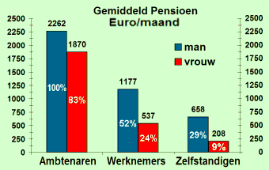
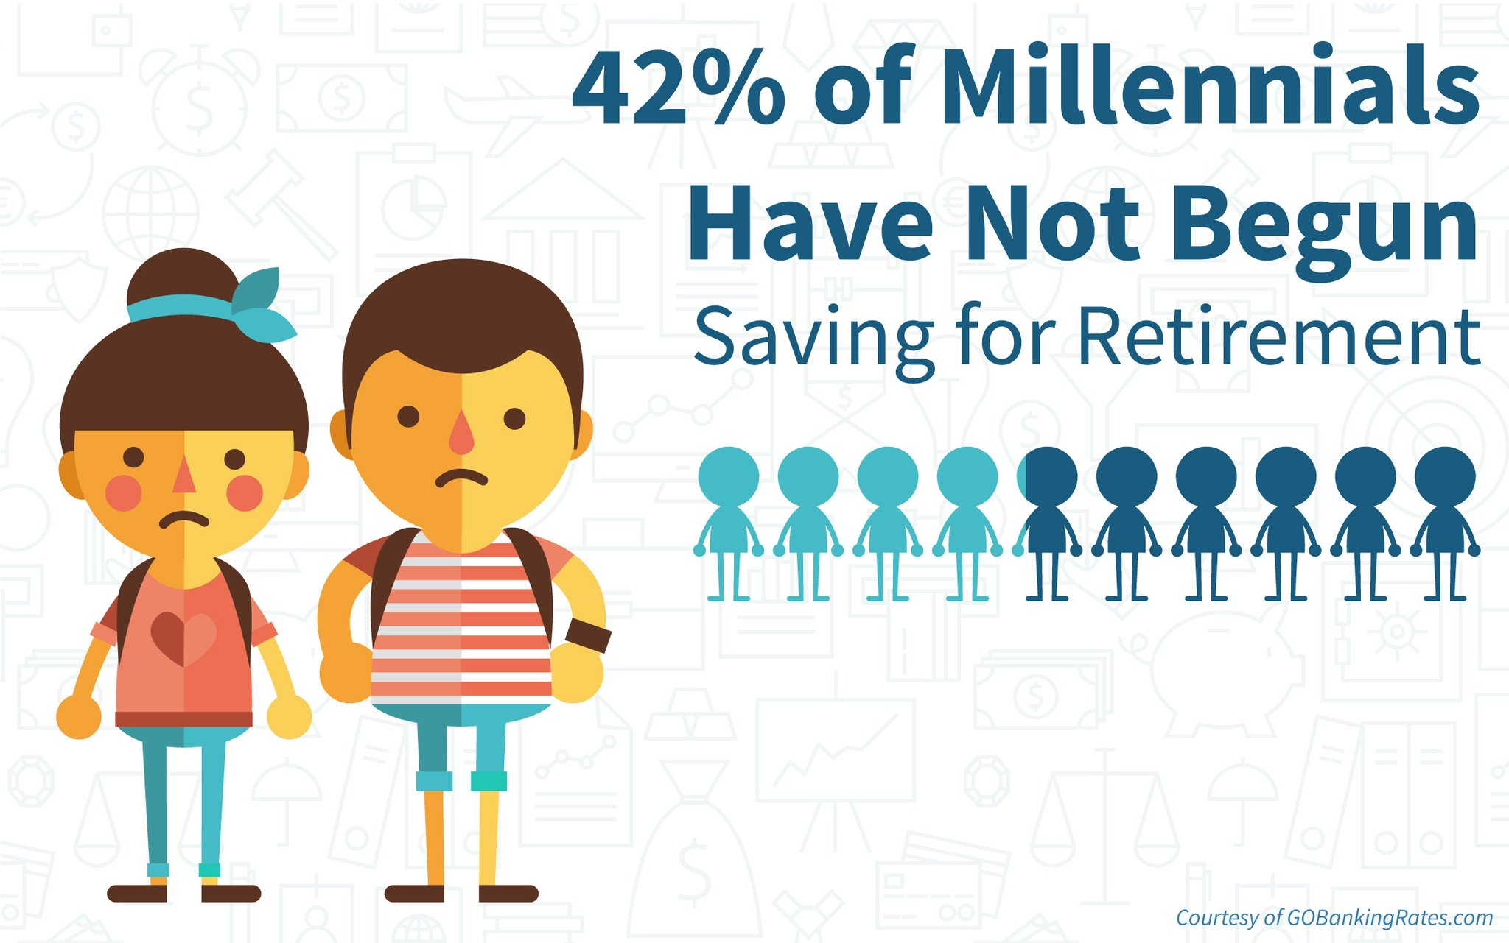
Why do you need a Pension Saving Plan?
How much will your government pension be after 45 years working ?
YOU NEED TO WORK UNTIL THE AGE OF 67
UNLESS YOU HAVE A FINANCIAL PLAN TO RETIRE EARLY
The government will pay you a pension of 1177 euro for a whole working career…
If you want to travel or need to pay medical care, that pension will soon appear not to be sufficient
Start saving early at young age in a pension fund

Slide 13



Why do you need a Pension Saving Plan?
Start creating a financial plan to retire as early as possible
AVOID FINANCIAL PROBLEMS AT OLDER AGE
IF YOU CAN NOT PAY A PENSION HOME
GOVERNMENT WILL DEMAND MONEY FROM YOUR KIDS
GOVERNMENT WILL ROB ALL YOUR MONEY !
MAKE SURE YOU HAVE A FINANCIAL PLAN
Notes:
Slide 13: Why do you need a Pension Saving Plan?
Make sure you don't have financial problems when you are old. Create a solid financial plan. Did you know that more than 25% of retirees in the US is still working as otherwise they are bankrupt. They still are paying off debt. In Belgium you need to make sure you have extra income from other sources so you don't become dependent from money from your kids. If you can not pay a pension home, the government will sell your house or ask money from your kids !
The government can ROB all YOUR money !! Be aware !! Make sure you have a plan where you can retire as soon as possible.

Slide 14
Your Financial Pyramid
Learn about each layer of your Life Financial Pyramid
Your Investments
At first your investment in dividend stocks or other activa will be small but apply the right strategy and this pyramid will turn
Your Savings for (grand)kids or other goals
Save money for a specific goal or dream that you have. You can also save money for your kids or grandchild. You decide.
Your Pension Saving Plan
Save a defined amount for your pension. This can be done through a pension fund, pension insurance plan or through your employer if they offer it.
Your Financial buffer
Establish your financial buffer of 6 to 18 months of your current salary and don’t touch it. Put it on a savings account for unexpected financial setbacks
Notes:
Slide 14: Your Savings for (grand)kids or other goals
The next layer in your Financial pyramid is saving for specific goals. Put a % of your salary aside for an objective that you want to save for. Put this money on a separate account that you will NOT touch until you use this money for this objective.

Slide 15




Why do you need to save for Specific Goals ?
Tell me some specific goals you want to do in 3 – 5 – 10 years ?
18 Years -> 2nd hand or new CAR
20 Years -> Travel EUROPE or WORLD
30 or 40 Years -> Buy a Apartment or HOUSE
Anything else…
Notes:
Slide 15 : Why do you need to save for Specific Goals ?
Some examples of longterm goals. At the age of 18, you might want to buy a car. At the age of 20 you may want to travel Europe or in the world. You may want to visit the Taj Mahal in India. This is for me the MOST BEAUTIFUL wonder and building in the world. Incredible how they build this ! You need to see it !
Maybe at age of 30 or older you want to buy a house or apartment. Maybe you have another dream...

Slide 16


How can you save for Specific Goals ?
Tell me some specific goals you want to do in 3 – 5 – 10 years ?
FIXED AMOUNT PER MONTH – PAY YOURSELF FIRST
SAVE THE MONEY AUTOMATICALLY BEFORE SPENDING MONEY AND PAYING BILLS
Notes:
Slide 16 : Why do you need to save for Specific Goals ?
How can you save for specific goals ? You pay yourself first each month ! You put a % of your salary aside from the monent you receive it. For example. You have a salary of 2000 euro. You put 120 euro on a savings account each month !
Focus also on spending your money on experiences instead of things. It's better to tell a nice exciting experience than bragging about the purchase of a "material thing".

Slide 17




One Specific Goal : Family Summer Vacation
Save Monthly for Expenses related to Experiences in life
EXAMPLE : YEARLY FAMILY SUMMER VACATION BUDGET FOR 2 ADULTS + 3 KIDS : 4500 EURO
BUDGET OF 4500 DIVIDED BY 7 MONTHS EQUALS TO….
GIVE ME THE ANSWER HOW MUCH I NEED TO SAVE…
643 EURO / MONTH
Notes:
Slide 17 : One Specific Goal : Family Summer Vacation
Let's use an example. If you want to do a yearly summer vacation, you need to save money, right?
A family of 5 (2 adults and 3 teenager kids) can require a vacation budget of 4500 euro. Here you see pictures of the vacation house we will rent in 2018. If you know you need 4500 euro, how much do you need to save each month in order to be able to pay this rental vacation house and expenses locally? Give me the answer...

Slide 18
Your Financial Pyramid
Learn about each layer of your Life Financial Pyramid
Your Investments
At first your investment in dividend stocks or other activa will be small but apply the right strategy and this pyramid will turn
Your Savings for (grand)kids or other goals
Save money for a specific goal or dream that you have. You can also save money for your kids or grandchild. You decide.
Your Pension Saving Plan
Save a defined amount for your pension. This can be done through a pension fund, pension insurance plan or through your employer if they offer it.
Your Financial buffer
Establish your financial buffer of 6 to 18 months of your current salary and don’t touch it. Put it on a savings account for unexpected financial setbacks
Notes:
Slide 18 : Your investments
The last layer in your financial pyramid is your investments. This is the layer where you will grow your money. All money that pay yourself in your investment account goes here.
Please know that the banks, nor schools will teach you how to grow money. Many people know how to put money on a savings account where you lose money. But not many people knowhow to grow money. It will be VERY IMPORTANT TO LEARN HOW TO GROW MONEY !

Slide 19
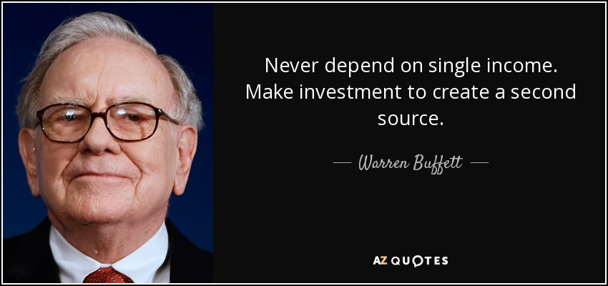
Why do you need to Grow YOUR MONEY ?
Learning HOW to grow your money is MOST IMPORTANT KNOWLEDGE AND SKILL !
BANKS do NOT help you to grow your money, they SELL financial products which gives them most profit and the banker a nice financial BONUS…
Today on a savings account you get 0,11% interest rate…you get poorer..
Your money NEEDS TO GROW each year !!
LEARN HOW TO INVEST and DO IT YOURSELF ! WE WILL TEACH IN FUTURE CLASSES
Notes:
Slide 19 : Why do you need to Grow YOUR MONEY ?
BANKS do NOT help you to grow your money, they SELL financial products which gives them most profit and the banker a nice financial BONUS…Today on a savings account you get 0,11% interest rate…you get poorer..
Your money NEEDS TO GROW each year !! And you are responsible for this. Otherwise you will work until you die.
LEARN HOW TO INVEST and DO IT YOURSELF ! WE WILL TEACH IN FUTURE CLASSES
Do you know what Warren Buffet says. Never depend on one income. If you lose your job, you are screwed. Make sure you create a second income. How ? We will teach you in future classes.

Slide 20
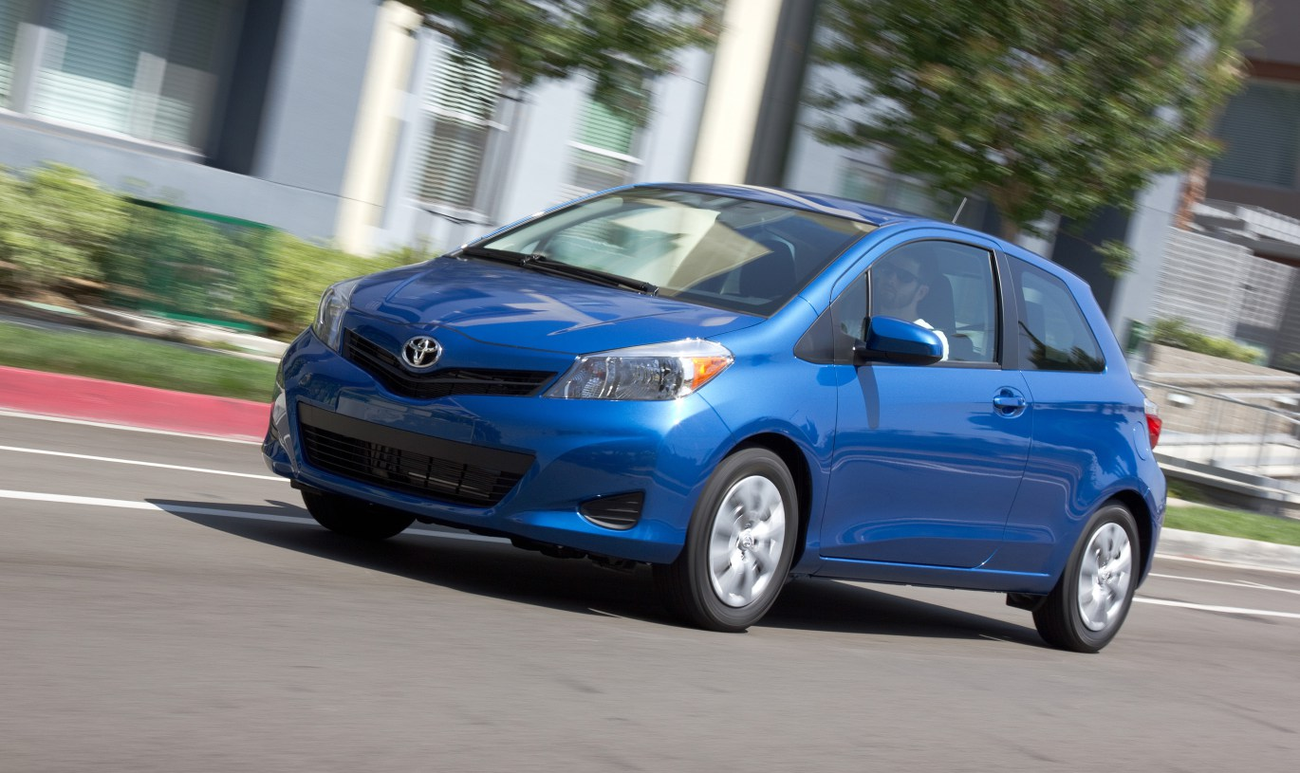

Now let’s create a Financial Plan
Let’s pick a long-term objective…
You are 13 Years OLD today ! Within 5 YEARS you will be 18 Years
What do you want to start saving for ??
40 HOURS = 2500 Euro
2nd Car = 7500 Euro
YOU NEED 10.000 Euro WITHIN 5 YEARS
Notes:
Slide 20 : Now let’s create a Financial Plan
Now let's pick a longterm financial objective. You are 13 years old today and enjoying life. In 5 years time you are 18 years old. What could you start saving for?
Let me pick an example. You can start to save for drivers' classes. 40 hours cost 2500 euro. You can save for a second hand car with a budget of 7500 euro. In total this is 10.000 euro, right ? You need this money within the next 5 years. This is an example of layer 3.
Your current income is money you receive from parents or grand parents today...

Slide 21


Let’s create a Financial plan !!
IN 2018 YOU RECEIVE A START AMOUNT OF 1.000 EURO
OUR GOAL IS TO GROW IT TO 10.000 EURO
WITHIN 5 YEARS
Notes:
Slide 21 : Now let’s create a Financial Plan
Now what will happen in 2018 ! In 2018 you receive from me a STARTING CAPITAL of 1.000 euro. Your goal in the next 5 years is to grow this 1.000 euro into 10.000 euro within 5 years.
I will NOT BUY a car for you, neither pay your driving classes. It is YOUR objective to grow this money and pay yourself these drivers' classes and buy your car.
How can we do that ? Let us do some brainstorming...

Slide 22
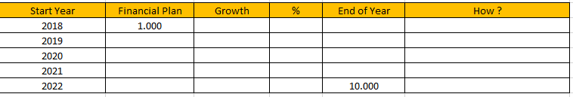
Exercise 2 : Let’s fill in YOUR PLAN
Fill in the amounts per year you want to achieve at the end of each year
Calculate % of growth and the amount you want to save, invest or earn
At YOUR birthday of 18 years old, YOU want to achieve 10.000 EURO !!
Notes:
Slide 22 : Exercise 2 : Let’s fill in YOUR PLAN
Here you see a financial spreadsheet by year. You start with 1000 euro and at the end of year 5 you need 10.000 euro. How do you want to grow this money ? Fill in by year how much hypothetical you want to add each year...
It is not important HOW. Just fill in your assumptions by year and think what you could do to grow this money when you are older...

Slide 23
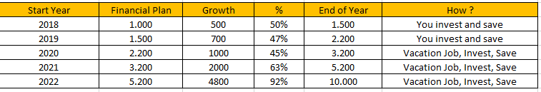

Exercise 2 : A Financial Plan
TELL ME YOUR IDEAS WHAT YOU CAN DO TO ACHIEVE THIS !!
Notes:
Slide 23 : Exercise 2 : A Financial Plan
Here's an example what I did fill in...At older age you can learn how to invest your money in the stock market. You can also do little jobs on the internet with skills you have, you can do a vacation job at the age of 17...
There are many possibilities...tell me some of your ideas.

Slide 24
FINAL TEST : Your Financial Pyramid
Name all the FOUR layers and what is the purpose ?
STEP 4 -> LAYER 4
STEP 3 -> LAYER 3
STEP 2 -> LAYER 2
FIRST STEP -> LAYER 1
Notes:
Slide 24 : FINAL TEST : Your Financial Pyramid
Now let's see if you have learned something today. EXAM TIME !!
Describe each name and purpose of the financial pyramid.

Slide 25
ANSWER: Your Financial Pyramid
Your Investments
At first your investment in dividend stocks or other activa will be small but apply the right strategy and this pyramid will turn
Your Savings for (grand)kids or other goals
Save money for a specific goal or dream that you have. You can also save money for your kids or grandchild. You decide.
Your Pension Saving Plan
Save a defined amount for your pension. This can be done through a pension fund, pension insurance plan or through your employer if they offer it.
Your Financial buffer
Establish your financial buffer of 6 to 18 months of your current salary and don’t touch it. Put it on a savings account for unexpected financial setbacks
Notes:
Slide 25 : ANSWER: Your Financial Pyramid
Here's the answer. Let's review your answers.

Slide 26

Final feedback
WHAT DID YOU LEARN ?
TELL ME YOUR KEY LEARNINGS OF TODAY

Slide 27

KEEP ON LEARNING EVERY DAY…

