Slide 1


8th World Wonder : Compound interest

Slide 2
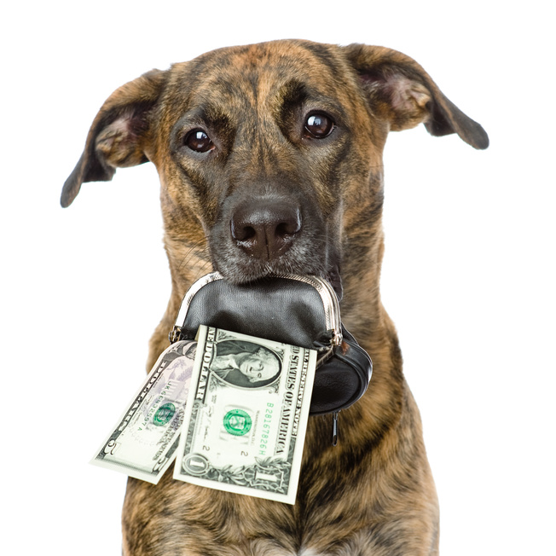
What did you learn last time ?
Let’s see what …you remember from the first class.
Tell me 3 key learnings from
Budg€t Fun

Slide 3
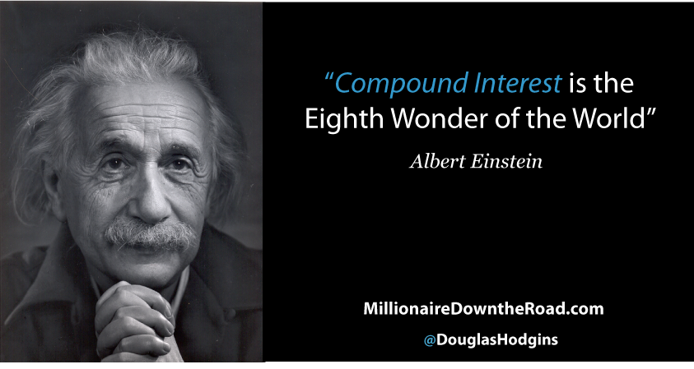
Educational Game about money

Slide 4
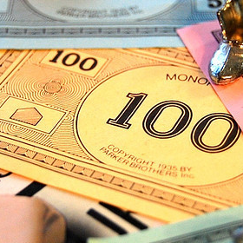
What you will learn today
The compound interest = the most important principle for growing your money
Be happy with what you have.
Money is a tool that can work for you. Use it wisely !
Ask questions if you don’t understand..
LEARN AND HAVE FUN

Slide 5
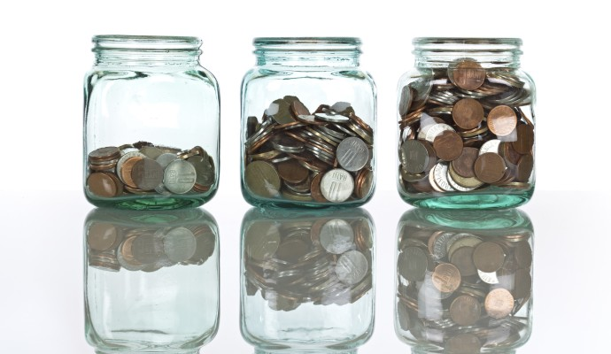
What is Compound Interest ?
Compound interest is a very simple way to grow your money….
Growing your money can be done with three key principles
Invest your money with a high return for example 7%
Re-invest what you earned again
Let time work out and don’t take risks. Do the same again and again..
TIME FOR YOUR CALCULATOR

Slide 6
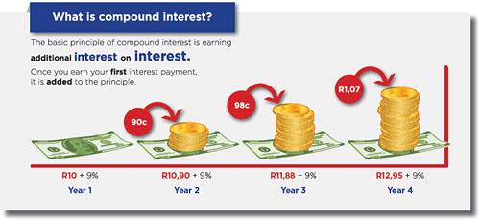
What is Compound Interest?
You have 10 Euro and your grow it with 9% over 4 years…how much do you have in year 5?

Slide 7

What is Compound Interest?
Let’s watch a YOUTUBE video to make sure you understand
https://youtu.be/immQX0RKFY0

Slide 8
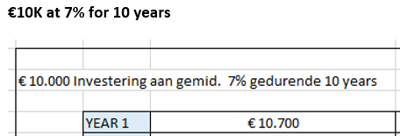

Exercise 1 : Let’s do some math
10.000 Euro – 7% during 10 years
You get each of you 10k from me
Today on a savings account you get 0,11% interest rate…you get poorer..
Your money grows 7% each year
How much money do you have in year 10 ?
What happens with your monthly amount?
What can you conclude ?
Ask questions if you need help…

Slide 9
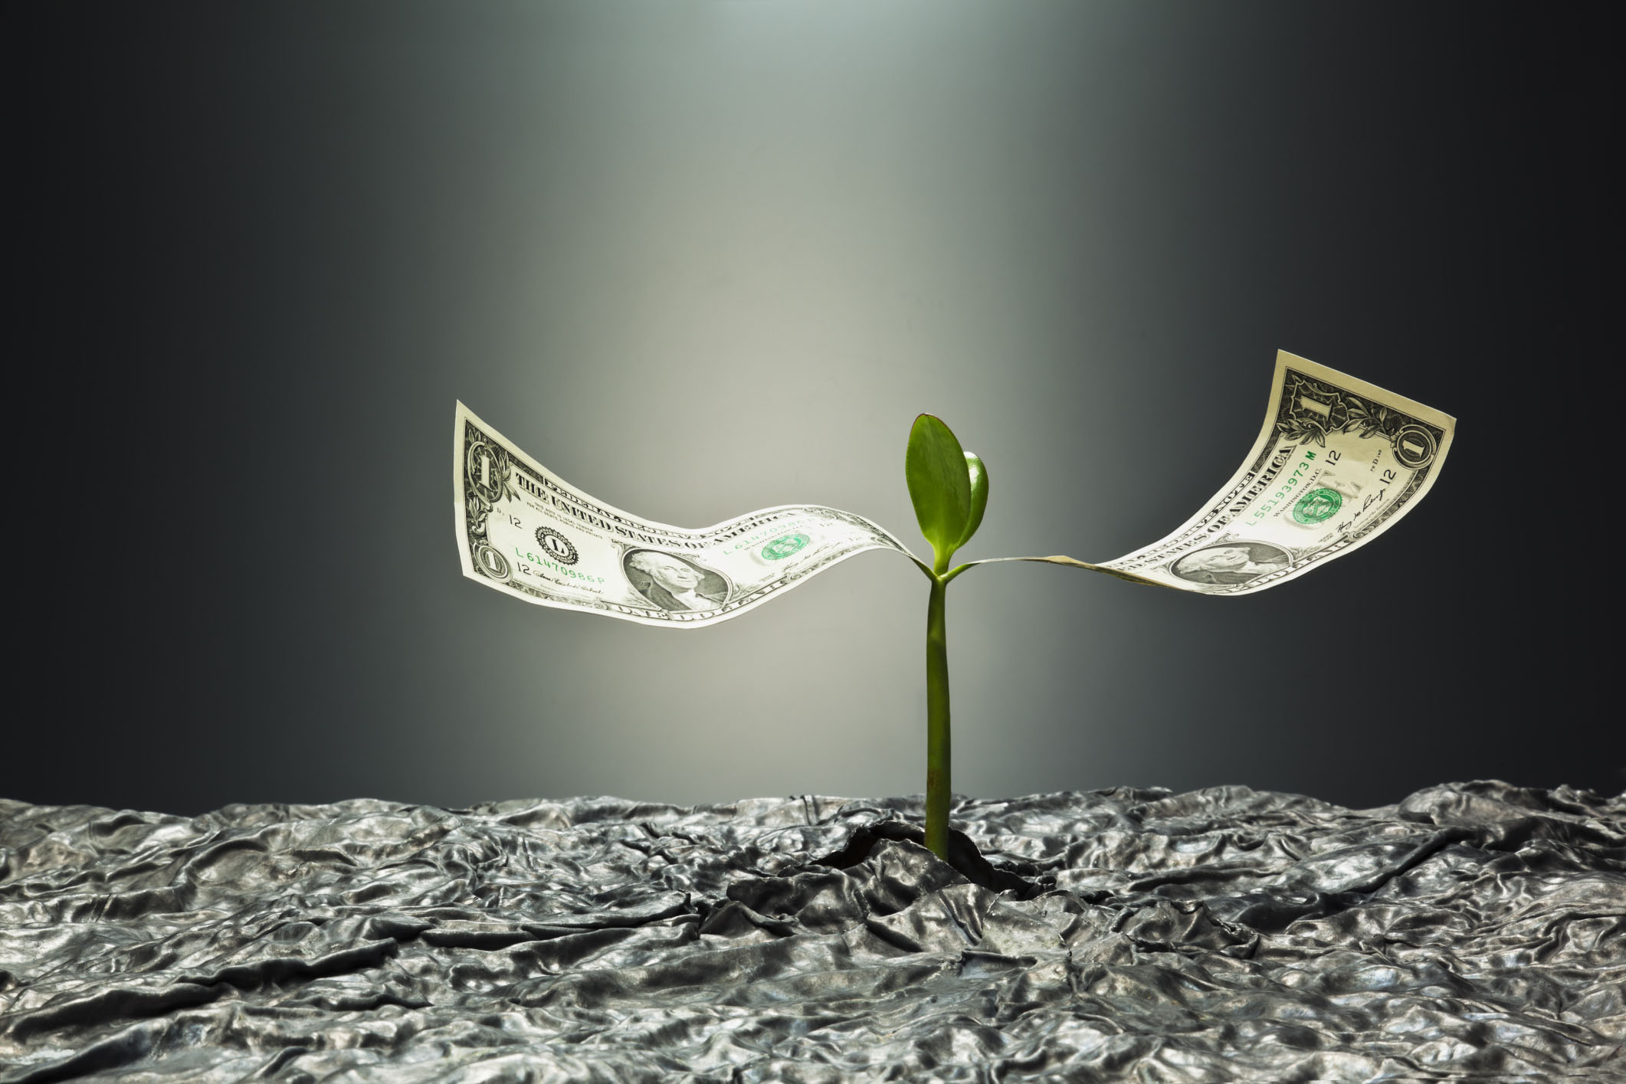
Exercise 2 : Let’s do some math
10.000 Euro – 15% during 10 years
Your money grows 15% each year
How much money do you have in year 10 ?
What happens with your monthly amount?
What can you conclude ?

Slide 10
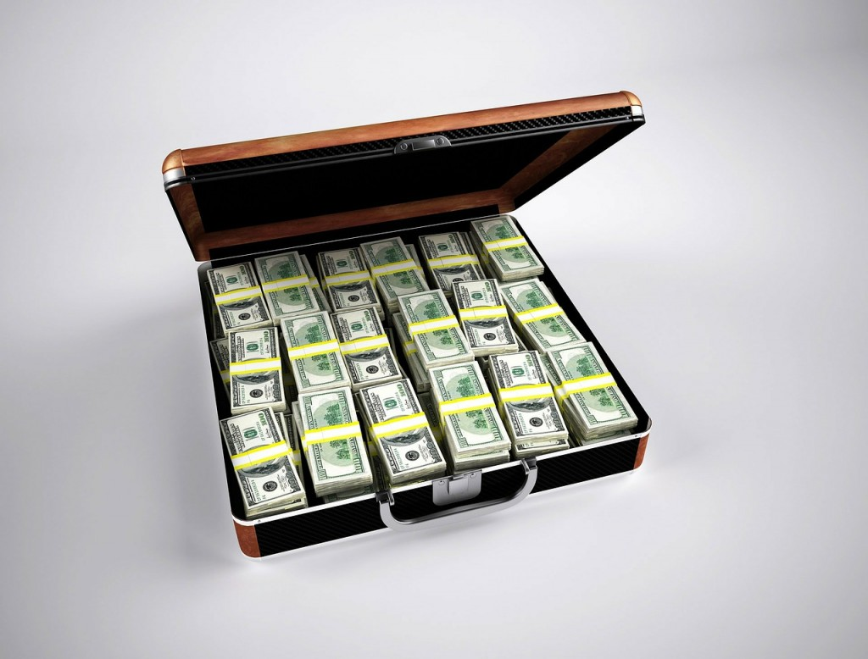
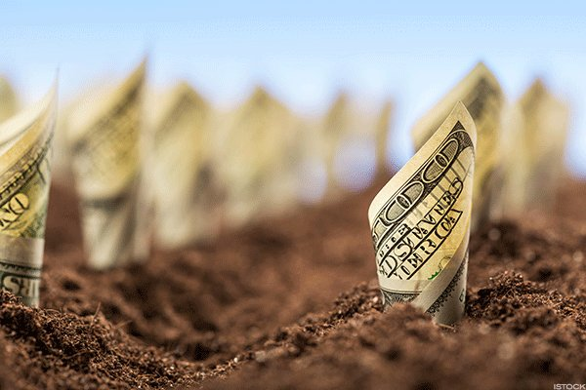
Question
CAN YOU GROW YOUR MONEY TO 1 MILLION $ or EURO?

Slide 11
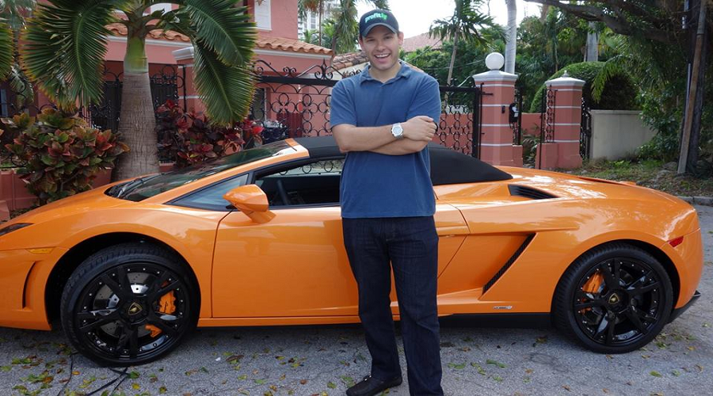
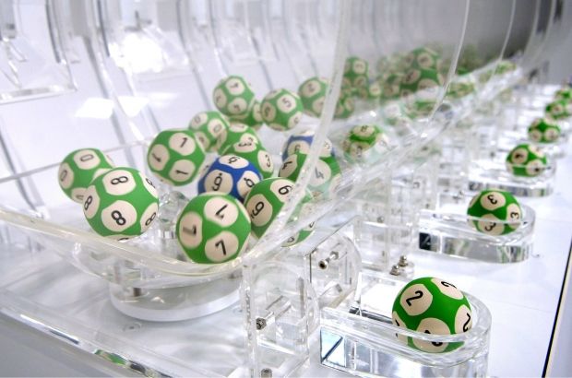

Question : what would you do with 1 million ?
WOULD YOU PLAY THE LOTTERY, BUY NICE THINGS, TRAVEL,…?

Slide 12

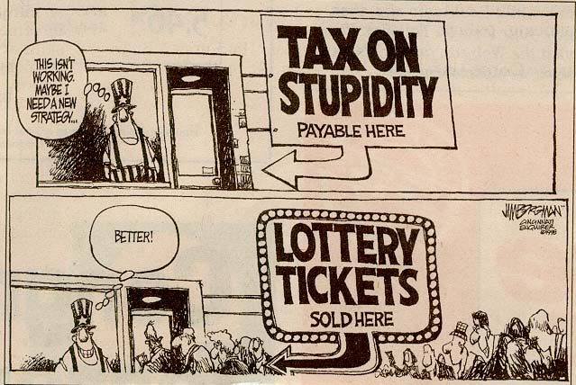
Correct answer

Slide 13
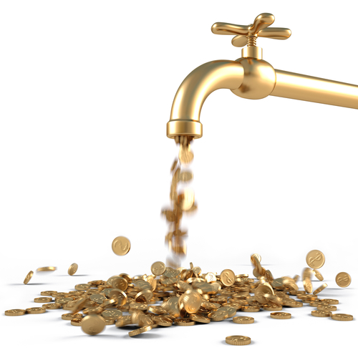
Correct answer
DOES A LUXURY CAR, HOUSE, … GIVE YOU MONEY EACH MONTH ?
INVEST ONLY IN ASSETS THAT GENERATE AND GIVE YOU MONEY

Slide 14
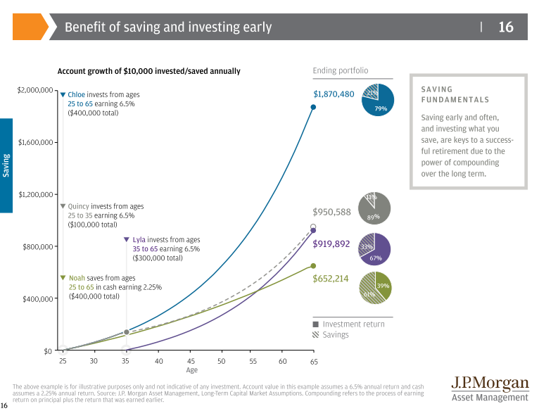
Let’s discuss an example of 4 people
10.000 Euro – Interest rate of 6,5%
Starting amount of 10k
4 different people Chloe, Quincy, Lyla and Noah
Chloe saves 10.000 each year. Quincy only 10 years, Lyla starts from her 35 only, Noah puts it on a savings account…
What can you conclude ?

Slide 15
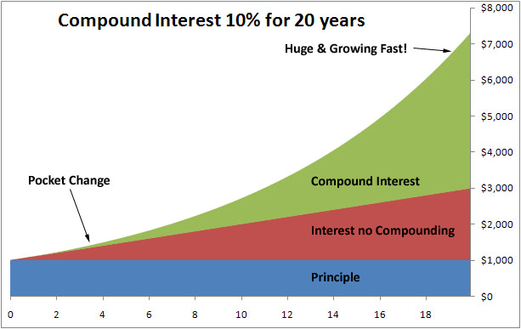
Key Principles of Compound Interest
ANNUAL RATE OF RETURN or GROWTH RATE (How fast you can grow your money…)
TIME
ADDITIONS TO YOUR AMOUNT PER YEAR

Slide 16
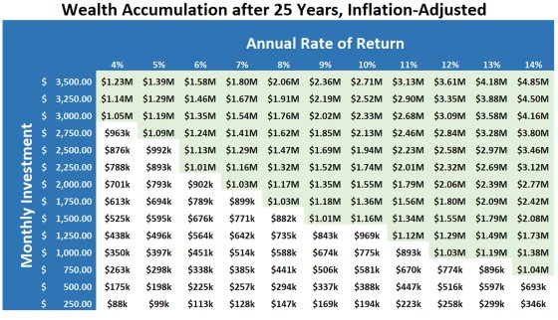
Growth of your money – Table
25 years with different Annual Rate of return and Monthly investments
WHAT CAN YOU LEARN FROM THIS TABLE ?

Slide 17


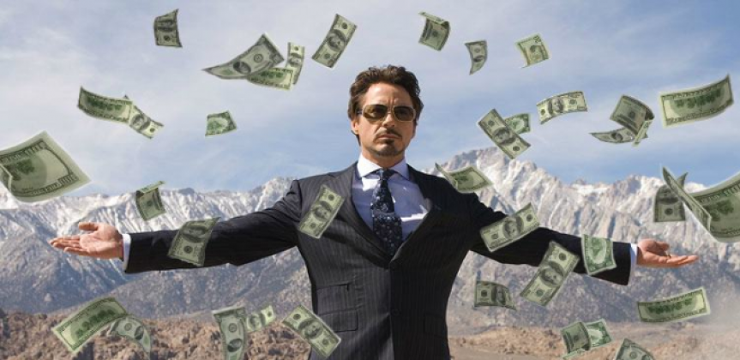
Do you think you can reach it?
What do you need to be successful ?
SAVE AND INVEST AS MUCH AS POSSIBLE ….

Slide 18




Your Financial Pyramid
Apply compound interest for the following three layers
Your Investments
At first your investment in dividend stocks or other activa will be small but apply the right strategy and this pyramid will turn
Your Savings for (grand)kids or other goals
Save money for a specific goal or dream that you have. You can also save money for your kids or grandchild. You decide.
Your Pension Saving Plan
Save a defined amount for your pension. This can be done through a pension fund, pension insurance plan or through your employer if they offer it.
Your Financial buffer
Establish your financial buffer of 6 to 18 months of your current salary and don’t touch it. Put it on a savings account for unexpected financial setbacks

Slide 19

Final feedback
WHAT DID YOU LEARN ?
TELL ME YOUR KEY LEARNINGS OF TODAY
WHAT ARE THE 3 KEY PRINCIPLES OF THE COMPOUND INTEREST?

Slide 20
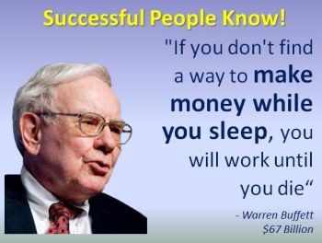
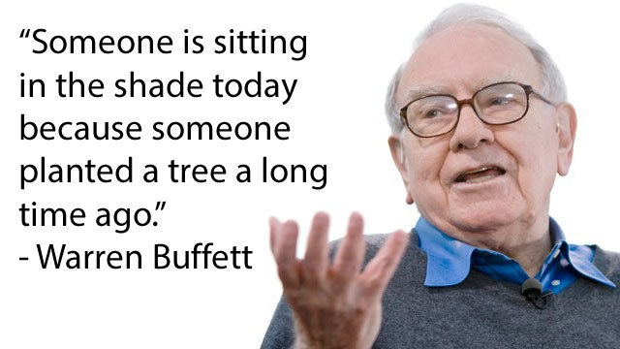
Warren Buffett : Most successful investor

Slide 21

Time for rewards
GREAT JOB TODAY
CONGRATULATIONS….TIME FOR A REWARD

Slide 22

KEEP ON LEARNING EVERY DAY…

Slide 23

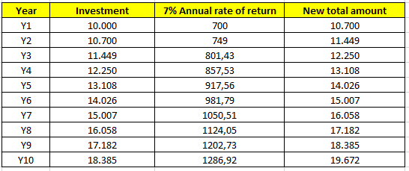
Answer to exercise 1

Slide 24
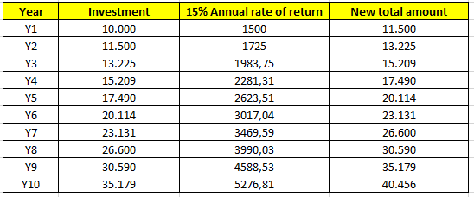

Answer to exercise 2

