Slide 1


Budg€t Fun

Slide 2

Educational Game about money

Slide 3

Rules of the game
Pursue and believe in your dreams
Be happy with what you have. No winners & no losers today…
Money is a tool that can work for you. Use it wisely !
Voice your opinion, discuss with each other, compromise but most important..
LEARN AND HAVE FUN

Slide 4


Task 1 : What is your FUTURE profession
Let’s see what is your first MONTHLY salary when you graduate….
Fill in your GROSS salary amount of your dream profession
https://www.vacature.com/salariskompas/

Slide 5


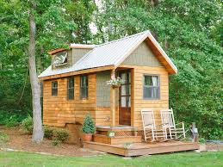
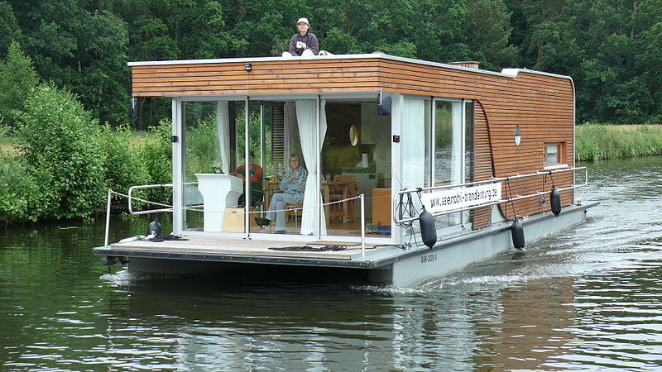

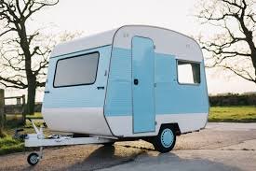
Task 2 : Where do you want to live?
What is your dream location to live alone? Fill in the MONTHLY RENT

Slide 6
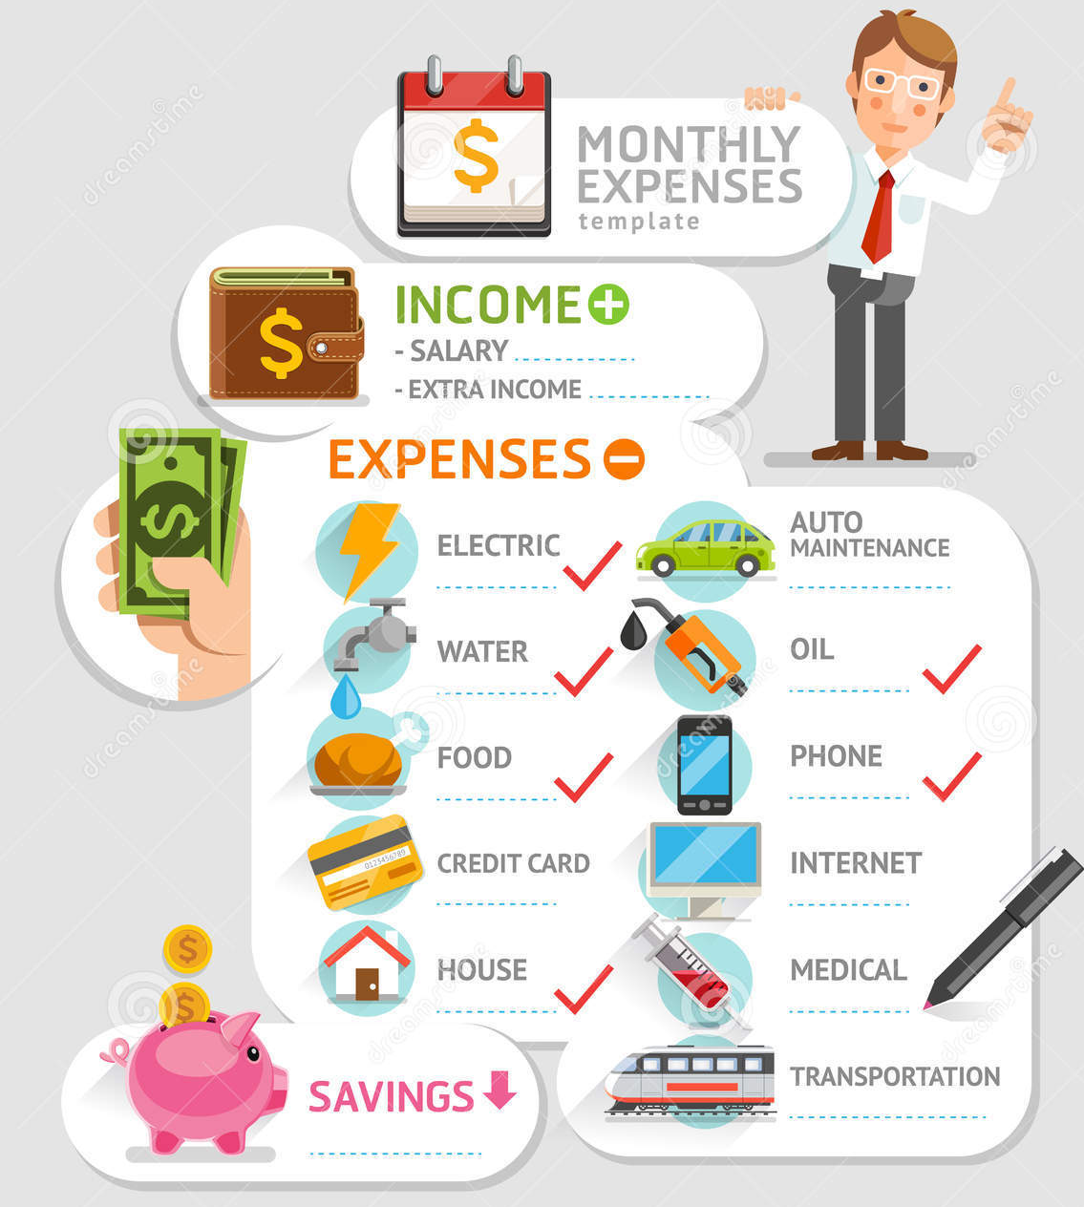

Task 3 : List out all your monthly expenses
Which monthly expenses do you think you need to pay?
Write down what you think you need to pay…fixed or variable
Think on what you need or want to spend money
Ask questions if you need help…
Use your imagination and brains

Slide 7

Task 4 : Compose Your Weekly DREAM Menu
Where are you in the buildout of your Financial Pyramid ?
Each of you creates a MENU of the day with breakfast, lunch and dinner
List all ingredients that you need to prepare your dream menu
Work together so you don’t waste food
Create for ONE day your dream menu where you ALL discuss and agree what parents will prepare for YOU..
Create a SHOPPING LIST
NOW let’s go SHOPPING

Slide 8

Task 4 : Shopping to do
Here’s what you need to do in the shop
Each of you searches his food and/or drinks and put it in the shopping basket
We will pay the bill assuming this is ONE weekly food and drinks expense.
At home, we will multiply this one week expense with a factor x3.5 for MONTHLY FOOD expense
Fill this amount in your budget sheet

Slide 9
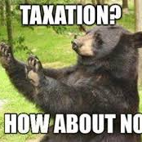
Task 5 : Make your Financial Summary
Reality check on your BUDGET Sheet
Give back 40% of your GROSS Salary for Belgian government. Yes, painful… we know ☹
We will review your expense items and give you our actual costs of the family
Fill the actual costs in your sheet
Make sure you have all costs in your list
See if you have any SAVINGS left …

Slide 10




Your Financial Pyramid
Where are you in the buildout of your Financial Pyramid ?
Your Investments
At first your investment in dividend stocks or other activa will be small but apply the right strategy and this pyramid will turn
Your Savings for (grand)kids or other goals
Save money for a specific goal or dream that you have. You can also save money for your kids or grandchild. You decide.
Your Pension Saving Plan
Save a defined amount for your pension. This can be done through a pension fund, pension insurance plan or through your employer if they offer it.
Your Financial buffer
Establish your financial buffer of 6 to 18 months of your current salary and don’t touch it. Put it on a savings account for unexpected financial setbacks

Slide 11
Our 5 Financial Steps Methodology
Take one step at a time
1. Your Financial Pyramid
3. Portfolio Strategy
5. Portfolio Analysis
Pick the right portfolio strategy that fits your risk profile.
Mistakes will be made but analyze constantly to cut out the investments that give you no more cash flow
Where are you on the financial pyramid ladder ? Are you ready to start with growing your money?
Where are you now?
2. Pay yourself FIRST
4. RIP Strategy
Know your financial situation or net worth before starting.
A critical step before you begin
The KEY to everything is to pay yourself first. Know your exact monthly amount and increase it over time. This strategy also works with small amounts of money
RIP stands for Re-Investment Strategy. Put every euro or dollar you earn back in the system to grow your money exponentially

Slide 12

Final Calculation
CALCULATE HOW MANY MONTHS YOU NEED TO SAVE TO HAVE 6 MONTHS
Tell me your FINAL result !

Slide 13

Final feedback
WHAT DID YOU LEARN ?
TELL ME YOUR KEY LEARNINGS OF TODAY

Slide 14

Time for rewards
GREAT JOB TODAY
CONGRATULATIONS….TIME FOR A REWARD

Slide 15

KEEP ON LEARNING EVERY DAY…

